Slide 1
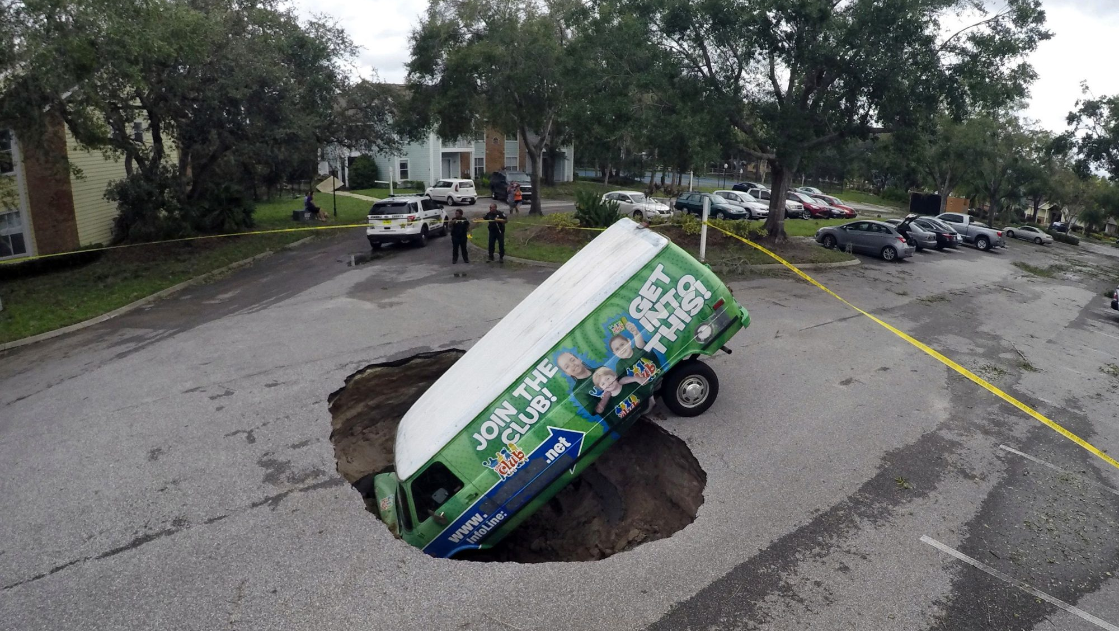
What’s down there?
An accessible guide to the ground beneath our feet

Slide 2
A simple and accessible guide to learning about the different rocks in your local area
Students learn about the geology of their area.
*Using maps, images & data from the Geological Survey Ireland website
www.gsi.ie

Slide 3
Learning Outcomes for the Lesson
Students will be able to:
To understand the role of Geological Survey Ireland.
To be able to navigate the www.gsi.ie website
To become familiar with the different layers e.g. relief, bedrock etc
To find our own Geographical Location (or any location) on the Ordnance survey map
To identify different rock types of their area/Ireland

Slide 4
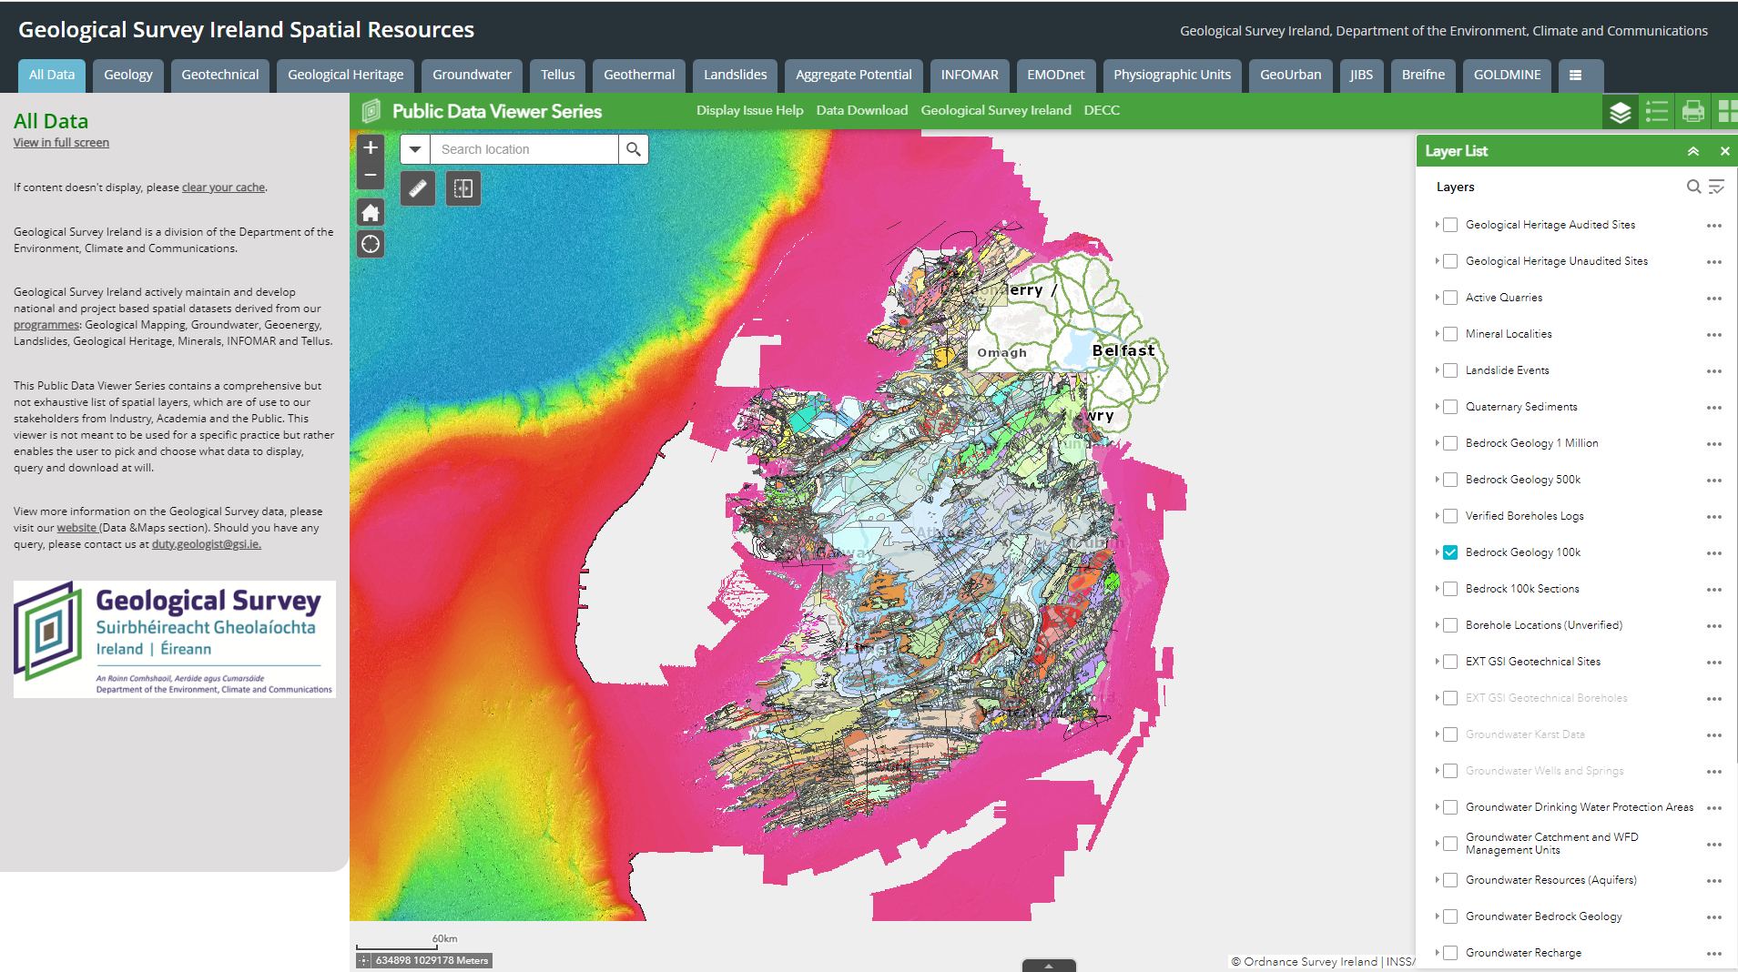
The journey starts here

Slide 5
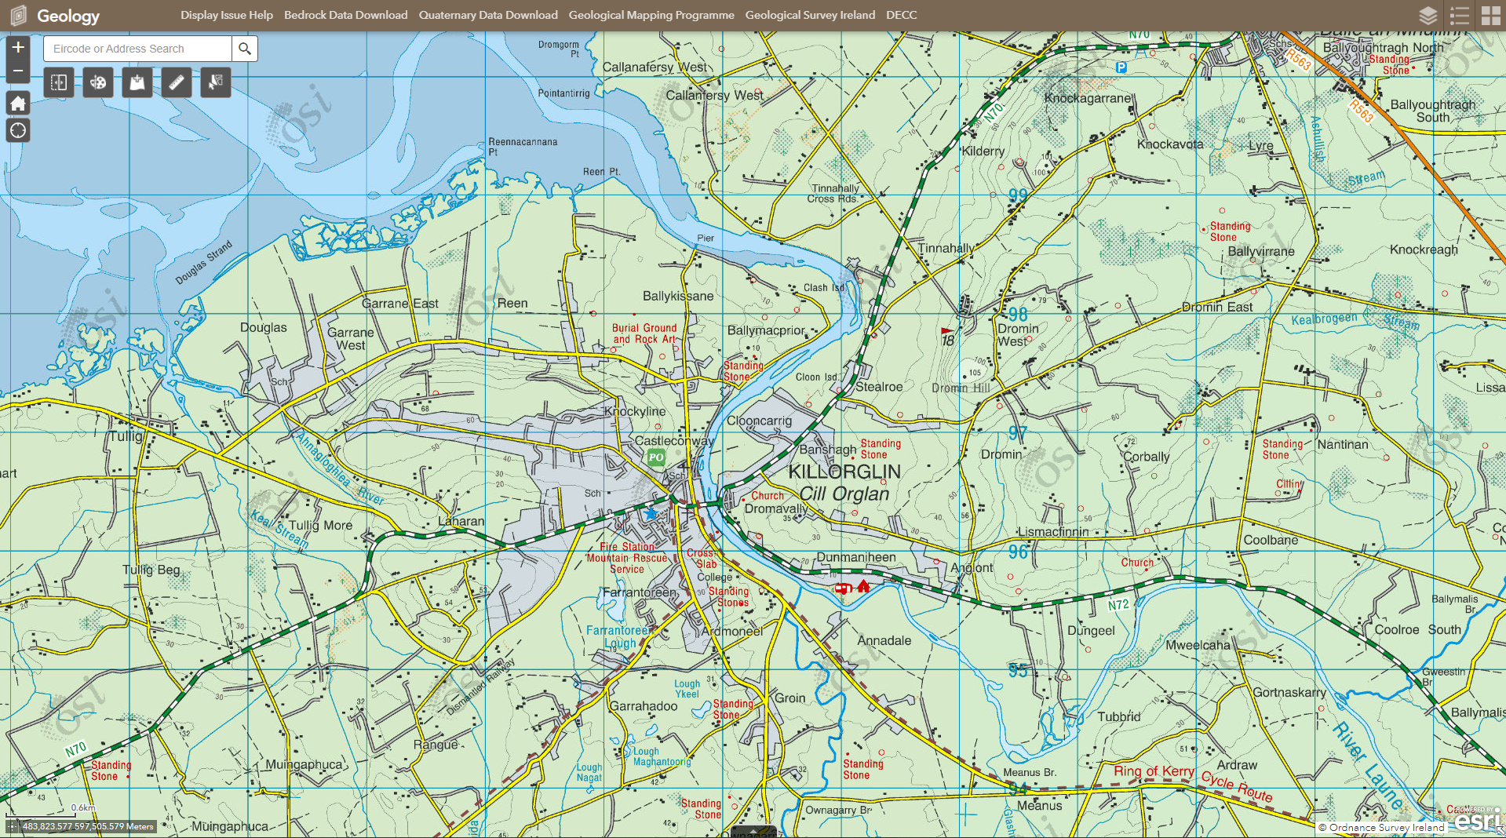
Find your town, village…

Slide 6
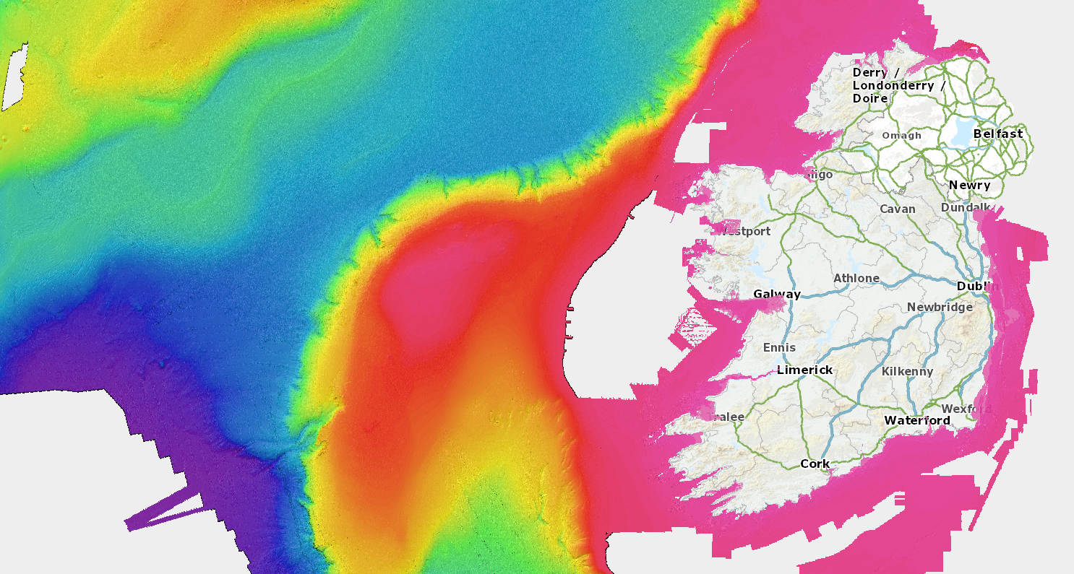
INFOMAR Bathymetry & Lidar Shaded Relief

Slide 7
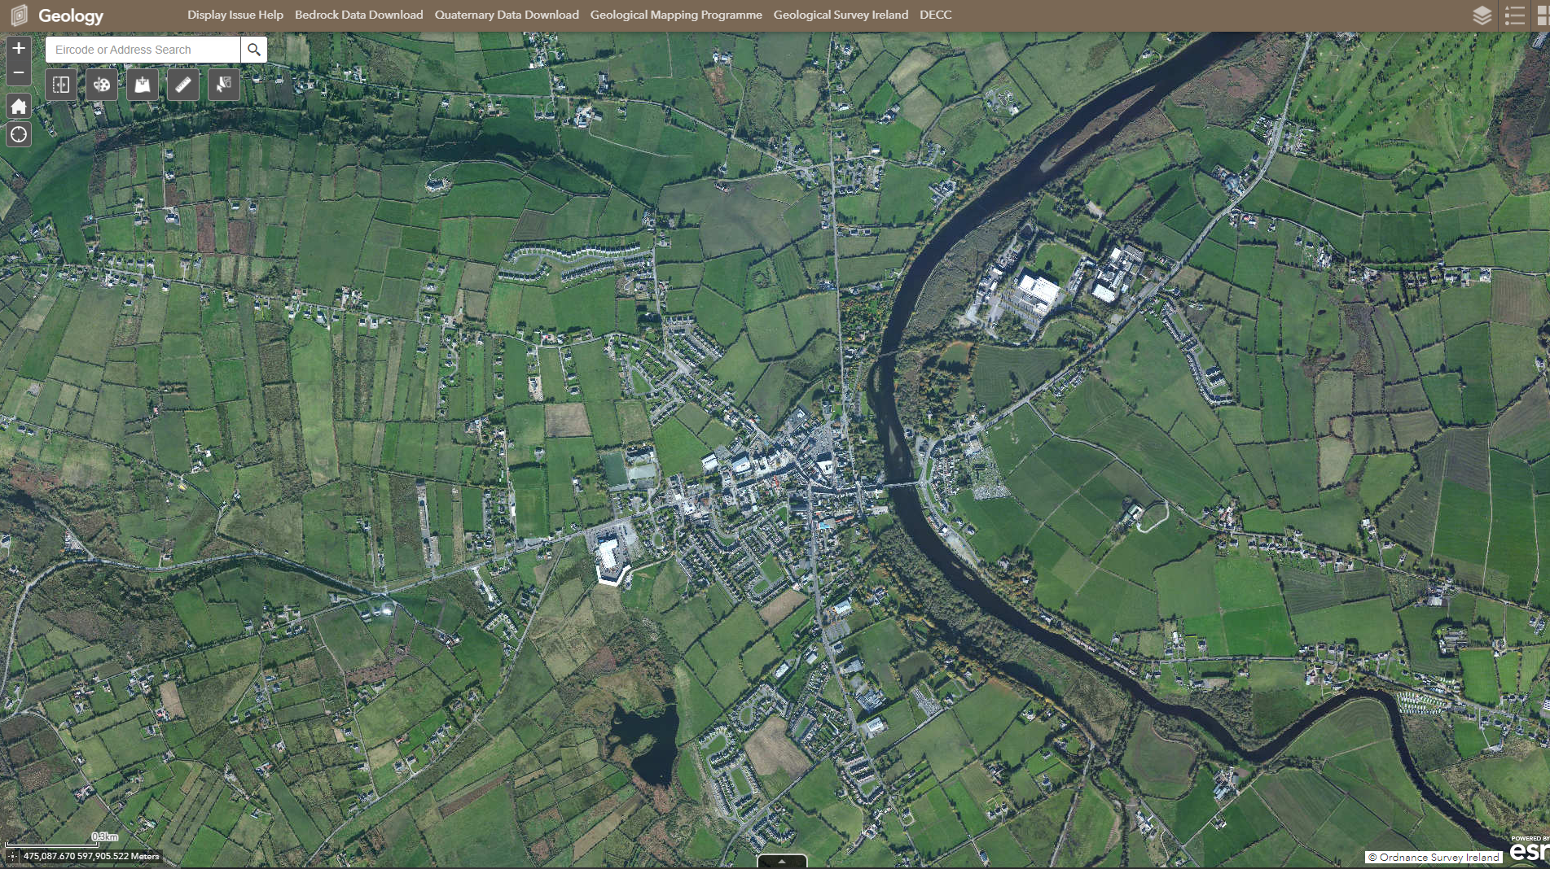
What does the surface look like?

Slide 8
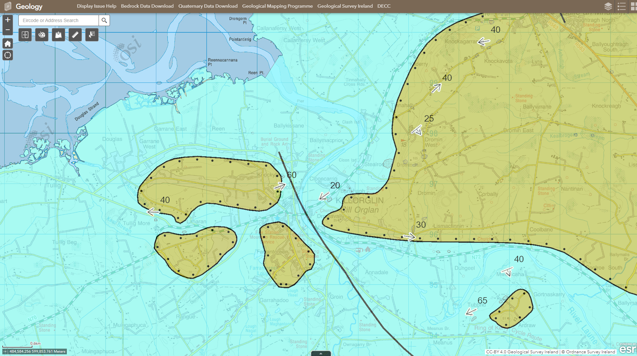
Find what’s under your town, village…

Slide 9
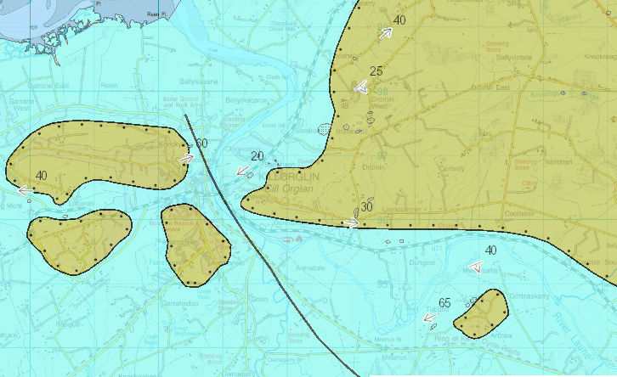
Bedrock Geology of the Killorglin Area
Sandstone (sandy colour)
Limestone
(blue colour)

Slide 10
Goal of the Lesson : To make geology accessible and recognise links to local information, features etc.
Students can work individually, in pairs or groups.
Print maps to make posters?
Additional Activities:
Links to other parts of the GSI mapper that might be of interest
Find out the age of the rocks
See where the rocks fit on a global scale: ics-chart (stratigraphy.org)
Print the maps for local walks and site visits
End of chapter: Identifying rock types- group activity (stations)

