Slide 1
Drumlins
Studying their effects on the landscape

Slide 2
True or False
Instructions: Read the statements and use your knowledge to decide if the statement is true or false.
1. Till is sediment deposited directly by a glacier. | T | F
2. The birthplace of a glacier is called a corrie. | T | F
3. The Irish landscape shows evidence of four periods of glacial advance. | T | F
4. Drumlins, moraines, fjords and eskers are all features of glacial deposition. | T | F
5. The Munsterian Glaciation began in Ireland about 175,000 years. | T | F

Slide 3
True or False
Instructions: Read the statements and use your knowledge to decide if the statement is true or false.
1. Till is sediment deposited directly by a glacier. | T | F
2. The birthplace of a glacier is called a corrie. | T | F
3. The Irish landscape shows evidence of four periods of glacial advance. | T | F
4. Drumlins, moraines, fjords and eskers are all features of glacial deposition. | T | F
5. The Munsterian Glaciation began in Ireland about 175,000 years. | T | F

Slide 4
Learning Intentions
Students will be able to:
Navigate the www.gsi.ie and www.maps.scoilnet websites
Recognise and locate drumlins on OS maps
Explain the formation of drumlins
Locate place names suggesting drumlins
Explain why roads twist and bend in drumlin regions
Recognise drainage patterns associated with drumlins on OS maps
Look at the type of farming practiced in drumlin regions.

Slide 5
keywords
Drumlins
Stoss slope
Lee slope
Unstratified
Boulder clay
Eustatic movement
Deranged drainage
Pastoral farming

Slide 6
Find your own area on the GSI website
Drumlins are displayed by the purple lines

Slide 7
Find your own area on Scoilnet maps

Slide 8
Drumlins
Description
A oval-shaped hill consisting of boulder clay.
25-100 metres high, half a kilometer in width and over 1 kilometer in length.
Has a steep slope called the stoss which faces the direction of the ice movement.
Has a gentle slope called the lee.
Consists of unstratified material(boulder clay)
Occur in swarms or clusters
‘Basket of eggs’ topography
The term “drumlin” is derived from Gaelic which means small hill.
Notes:
Shape is often referred to as egg-shaped or whaleback-shaped hills.

Slide 9
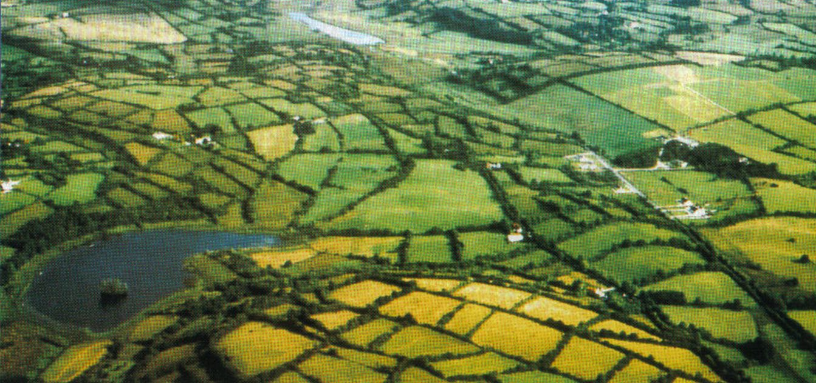
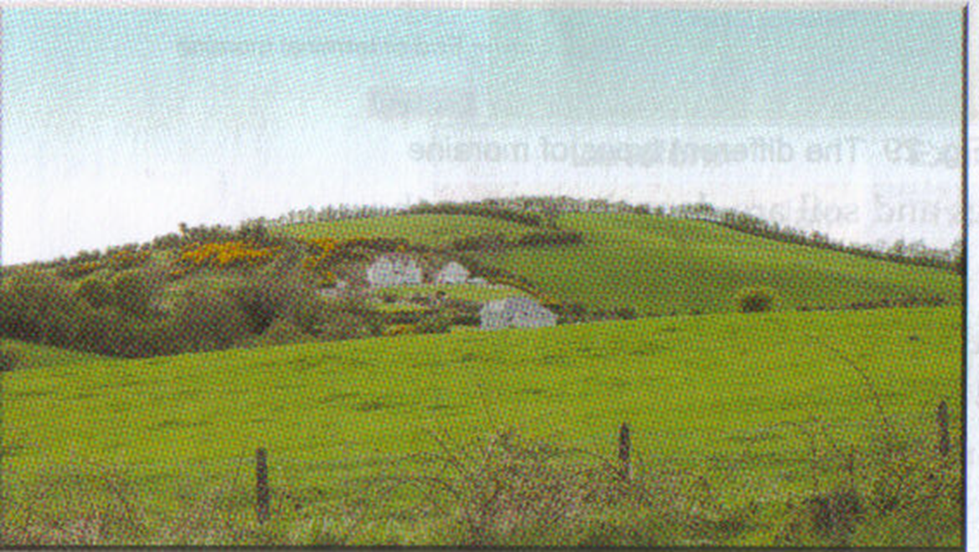
Photos of drumlins

Slide 10
Diagram of a drumlin
Direction of ice flow
Lee slope
Stoss slope
long axis
Steep end (stoss)
Gentler, lee side

Slide 11
Formation
Glacial ice deposits boulder clay into irregular heaps.
The boulder clay is unstratified material and impermeable.
The ice retreats and then advances again.
This time the ice shapes and smooths the boulder clay into rounded oval-shaped hills.
Drumlins show the direction of glacial movement.
The steep slope of the drumlin is the direction from which the ice advanced.
The gentle slope points to the direction in which the ice was travelling.

Slide 12
Drowned Drumlins
Drowned drumlins were created, as seen here in Clew Bay, when the ice melted at the end of the last ice age some 10,000 years ago, causing sea levels to rise (eustatic movement). The drumlins appear as low islands surrounded by seawater.
Notes:
A rise in temperature released vast volumes of water back to the sea when ice sheets melted.

Slide 13
Drowned Drumlins
The image shows drumlins that were deposited by a glacier in the waters of Clew Bay.
The blue on the image indicates deeper water and the lighter colours from yellow to red show shallower waters.
This image was collected by INFOMAR using bathymetric (measuring water depts) imagery.

Slide 14
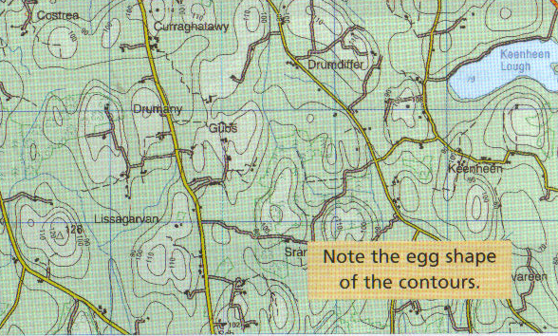
Recognising drumlins on an O.S. map
Drumlins in Cavan

Slide 15
What is the direction of ice movement shown by the drumlins? Choose 5 drumlins and work out their average height.

Slide 16
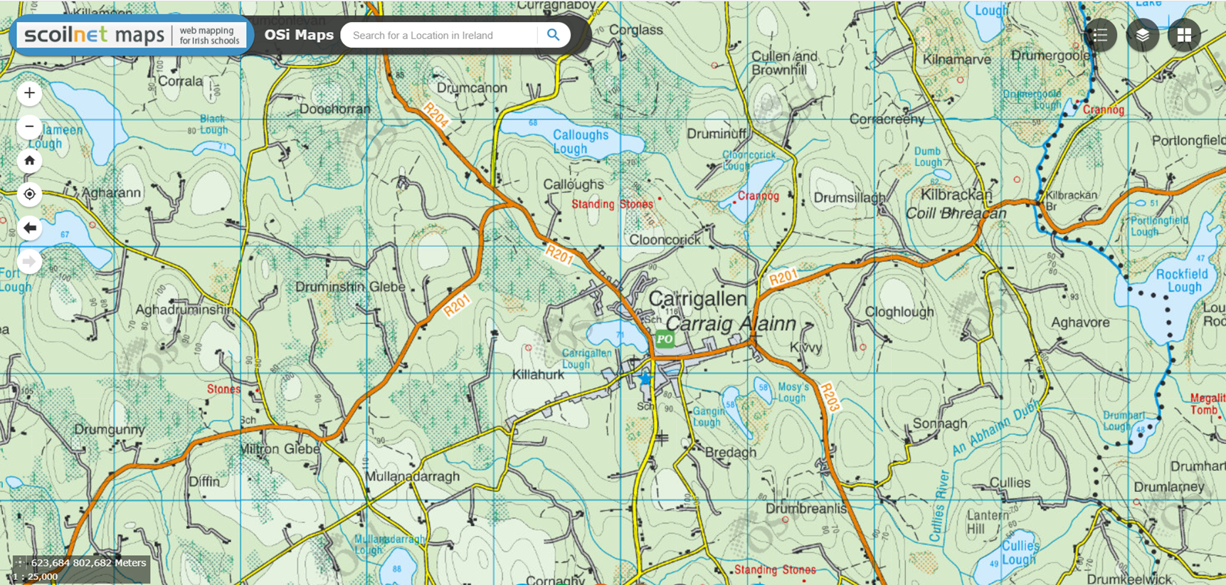
Place names
Drum, Drom, Droim, Drim = hillock (drumlin)

Slide 17
Transport
The R201 is a good example of how the road network has been influenced by drumlins. It follows a long winding route to avoid drumlins.
Notes:
The R201 overcomes the local relief

Slide 18
Drainage Patterns
4 types of drainage patterns
1. Dendritic
2. Radial
3. Trellised
4. Deranged

Slide 19
Deranged drainage pattern
Deranged drainage pattern occurs where glaciation has affected the landscape.
Drumlins may impede drainage. Trapped water ranging from pools to oddly shaped lakes.
Rivers have no definite pattern, they are irregular in appearance.
Rivers flow in a deranged pattern between the drumlins of Cavan, Leitirm and Monaghan

Slide 20
Deranged drainage pattern in diagrams

Slide 21
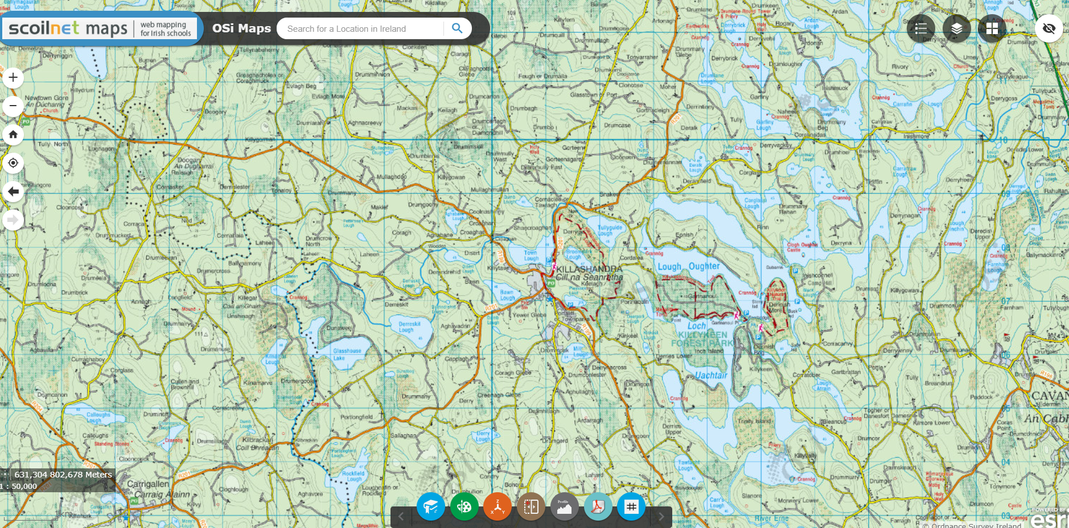
Deranged drainage patterns occurs in the Killeshandra area of Cavan

Slide 22
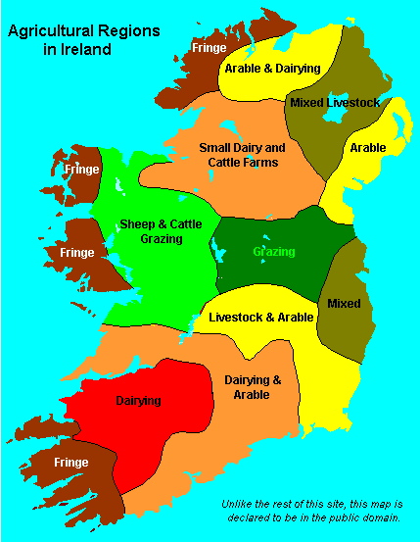
Agriculture
The material deposited by ice is unstratified
and impermeable.
Suitable for pastoral farming.
Dairy and beef farming is practiced in Cavan
and Leitirm.

Slide 23
Keywords Explained
Stoss slope: is the steep side which faces the direction of the ice movement.
Lee slope: is the gentle side which is lower in height.
Boulder clay: is material deposited by ice over a large area. It is an unsorted mixture of fine clay and large rocks called boulders. Boulder clay is very fertile.
Deranged drainage: occurs when rivers have no definite pattern, they are irregular in appearance.

Slide 24
Learning Intentions
Students will be able to:
Navigate the www.gsi.ie and www.maps.scoilnet websites
Recognise and locate drumlins on OS maps
Explain the formation of drumlins
Locate place names suggesting drumlins
Explain why roads twist and bend in drumlin regions
Recognise drainage patterns associated with drumlins on OS maps
Look at the type of farming practiced in drumlin regions.

Slide 25
Past questions on drumlins

Slide 26
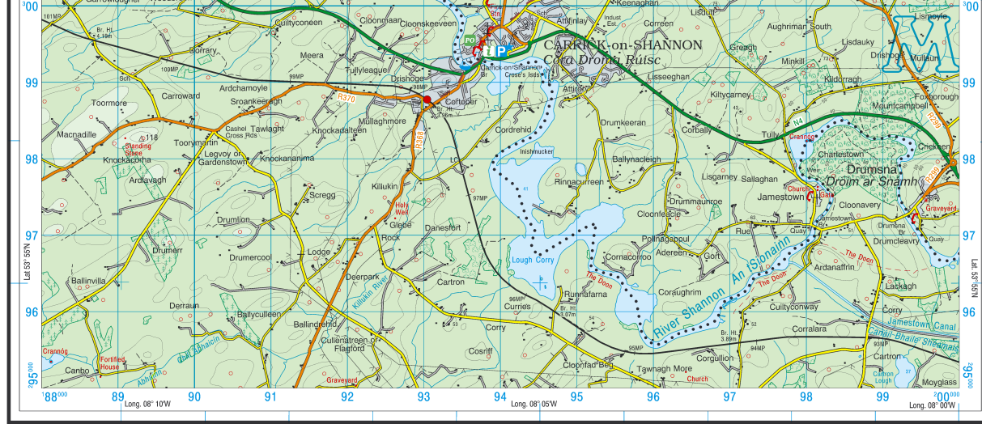
Name the feature of glacial deposition found in grid square M 94 95.
Examine the long axis trend of the feature named in the part above. From which direction did the ice sheet originate?

Slide 27
Identify the drumlin in the aerial photo of Carrick-on-Shannon.

