Slide 1
Seismic activity

Slide 2
Causes of seismic activity
Lesson one

Slide 3
Learning outcome: lesson one
Understand the causes of seismic activity.

Slide 4
What is a earthquake
An earthquake is a sudden and rapid shaking of the earth's surface caused by the release of energy stored in rocks.

Slide 5
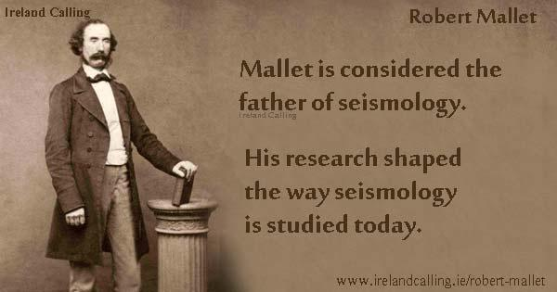
Key terms
Seismology- study of earthquakes
Seismologist- someone who studies earthquakes
Additional information:
Founder of seismology was an Irish man by the name of Robert Mallet (1810-1881)

Slide 6
Robert mallet
In October 1849, Mallet carried out experiments on Killiney Beach to examine how fast energy passed through various materials including rocks and sand. Along with his son they buried kegs of gunpowder in the sand and detonated them. Father and son then measured how long it took the shock waves to travel over a set distance.
https://www.dias.ie/2010/10/19/geophyicsrobertmallet/?option=com_content&view=article&id=3961:geophysicsmalletbook&catid=148

Slide 7
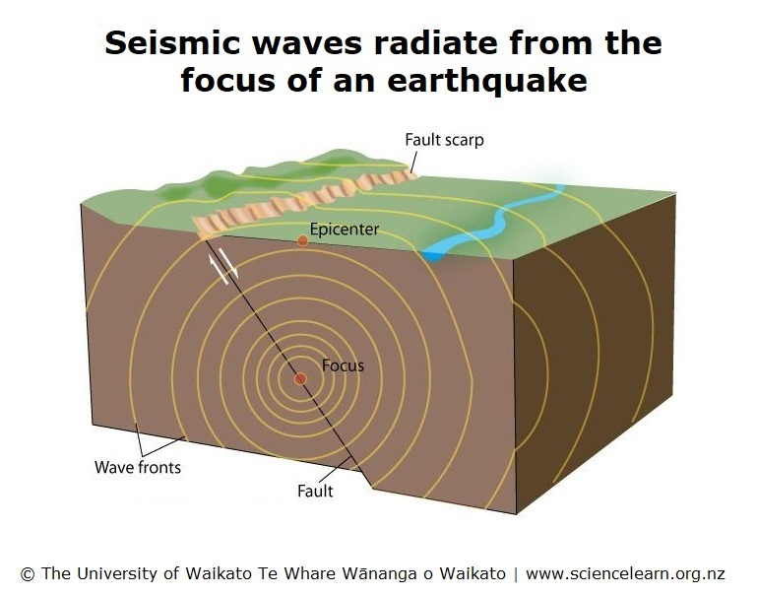
https://www.sciencelearn.org.nz/resources/340-seismic-waves

Slide 8
Causes of earthquakes
Plate movement.
Natural processes.
Human activity.
To see the most recent earthquakes detected in Ireland the Irish National Seismic Network:
https://www.insn.ie/

Slide 9
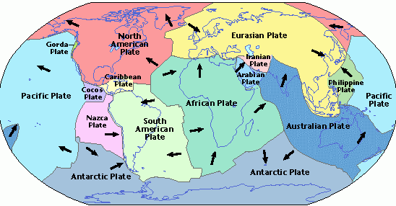
https://brebecca.weebly.com/plate-tectonics.html

Slide 10
Tectonics
Forces of plate tectonics have shaped the Earth as the huge plates that form the Earth’s surface slowly move towards, away, over, under and past each other
When the accumulated energy grows strong enough, the plates break free (move). If an earthquake occurs in a populated area, it may cause many deaths and injuries and extensive property damage.
Point at which the earthquake starts is the focus.
Epicentre- point directly above the focus on the earth’s surface where the most damage occurs.
Seismic belt- areas of earthquake activity.

Slide 11
Most earthquakes occur along plate boundaries particularly at convergent (e.g.Turkey) and transform (e.g. San Andreas Fault) boundaries. Known as seismic belts.
10% of earthquakes occur within plates. As plates continue to move and plate boundaries change over geological time, weakened boundary regions become part of the interior of plates.
These zones of weakness within the continents can cause earthquakes in response to stresses that originate at the edge of the plates or in the deeper crust.

Slide 12
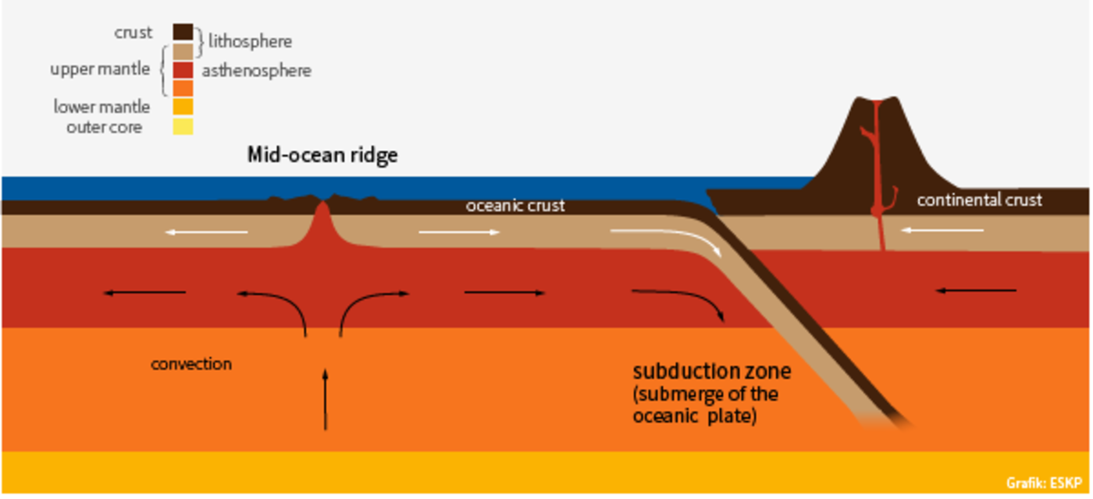
https://www.eskp.de/en/basic-knowledge/natural-hazards/plate-tectonics-and-volcanism-935407/

Slide 13
Try this little experiment
Break a block of foam rubber in half.
Put the pieces on a smooth table.
Put the rough edges of the foam rubber pieces together.
While pushing the two pieces together lightly, push one piece away from you along the table top while pulling the other piece toward you. See how they stick?
Keep pushing and pulling smoothly.
Soon a little bit of foam rubber along the crack (the fault) will break and the two pieces will suddenly slip past each other. That sudden breaking of the foam rubber is the earthquake. That's what happens along a strike-slip fault.
https://www.mtu.edu/geo/community/seismology/learn/earthquake-cause/

Slide 14
Natural causes
Volcanic eruption
https://youtu.be/JypTLDLABzM
Glacial activity
Reactivated fault lines

Slide 15
Glaciers causing earthquakes
Glaciers are huge massive of ice:
They exert a lot of pressure on the earths surface when intact.
When they melt pressure is released and can cause earthquakes

Slide 16
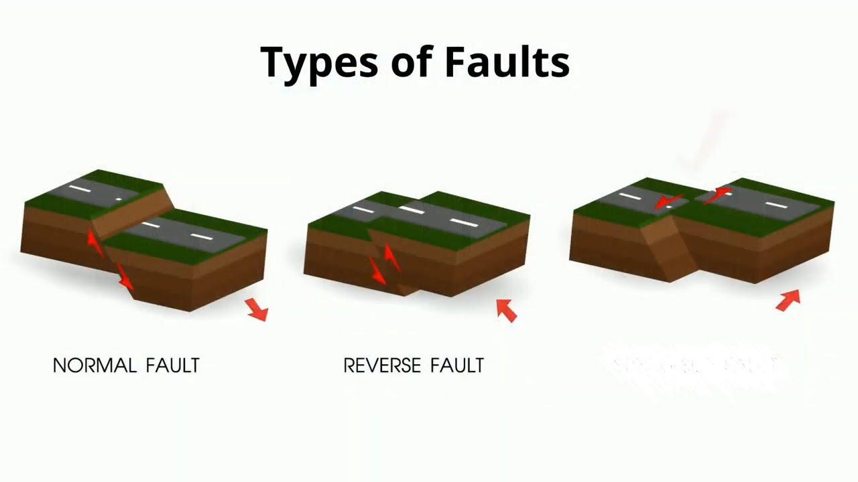
Fault lines
A fracture between two blocks of rocks.
Normal fault
Reverse fault
Transform fault
Transform fault
Transform fault

Slide 17
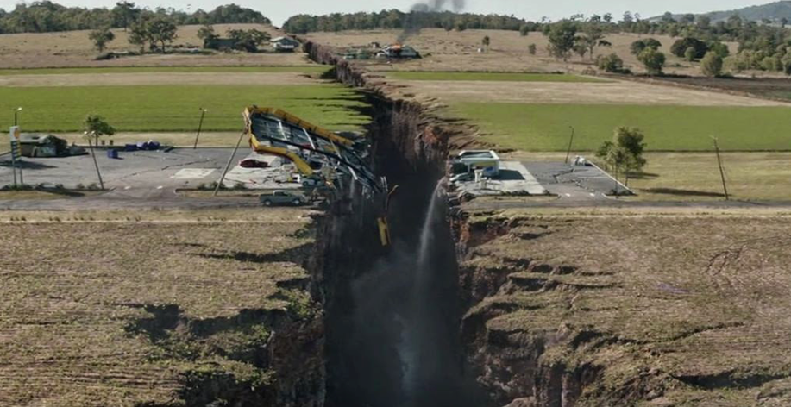
Faults and earthquakes
Earthquakes take place as a result of the sudden release of energy during fault movement.
https://seismo.berkeley.edu/blog/2017/05/04/The-mystery-about-earthquake_fissures.html

Slide 18
Human activity
Fracking
Quarrying/mining
Dam building
Nuclear bombs

Slide 19
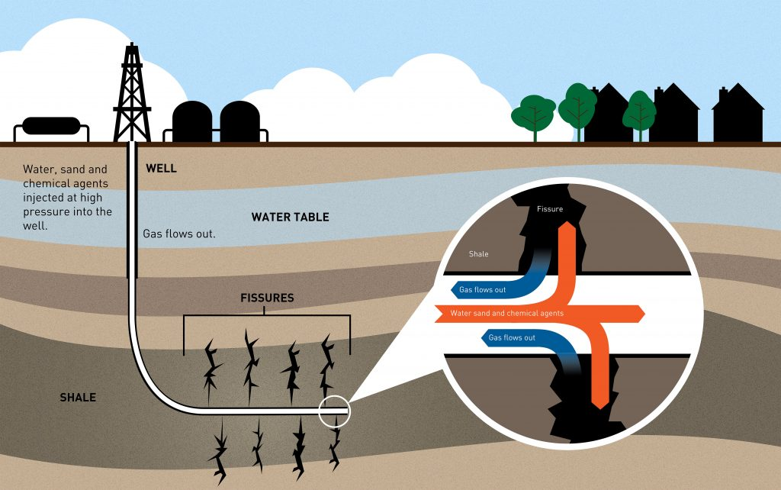
Fracking
Fracking is banned in Ireland since 2017.
https://www.pbs.org/newshour/science/earthquakes-triggered-by-fracking

Slide 20
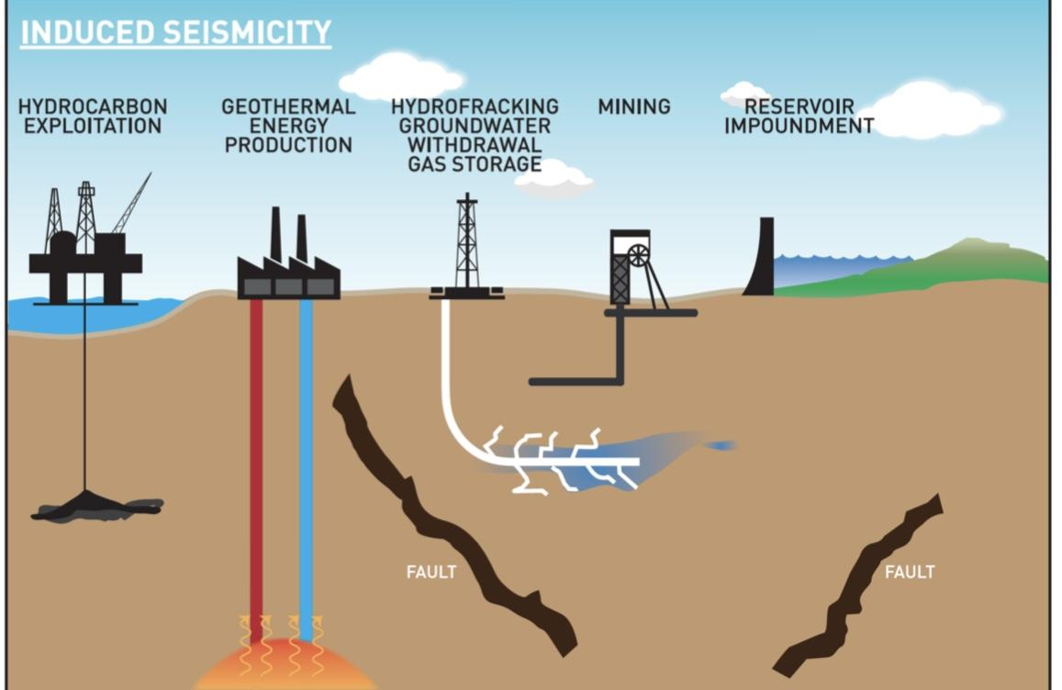
https://www.earth-prints.org/bitstream/2122/11037/1/2018Ant_Braun%26al_IS.pdf

Slide 21
Nuclear bomb
https://www.usgs.gov/faqs/can-nuclear-explosions-cause-earthquakes?qt-news_science_products=0#qt-news_science_products
seismologists can tell the difference between an big explosion and a small earthquake.
During the cold war the US could tell when the Soviets were testing nuclear bombs as the seismics of explosions are different from natural earthquakes.

Slide 22
activity - project
Students should first state what is meant by seismic activity.
List the different causes of seismic activity.
Briefly explain each cause. Focus on plate tectonics and how either convergent or transform boundaries create earthquakes.
Focus on one of the natural process causes in a bit more detail.
Look at one human cause in detail.

Slide 23
Key terms recap
Seismology- the study of earthquakes.
Seismologist- a person who studies earthquakes.
Seismic belts- areas of earthquake activity, mainly found at plate boundaries.
Convergent boundary- where plates collide, also known as destructive boundaries.
Divergent boundaries- where plates separate, also known as constructive boundaries.
Transform boundaries- where plates slide past each other, also known as conservative boundaries.

Slide 24
Key terms recap
Focus- point at which an earthquake starts.
Epicentre- the point directly above the focus on the earth’s surface, where most damage occurs.
Fault lines- a fracture between two blocks of rocks.
Escarpments-an area separating two level land surfaces that occur as a result of faulting.
Fracking- process of drilling down into the earth before a high-pressure water mixture is directed at the rock to release the gas inside.
Quarrying- process of extracting rock from the earth’s surface.
Fissures- a fracture in rock.

Slide 25
Measurement of seismic activity
Lesson two

Slide 26
Learning outcome
Understand how seismic activity can be measured.
Understand how we measure seismic activity in Ireland.

Slide 27
Key terms
The point inside the Earths crust where the energy is released is called the focus.
The point on the surface above the focus is called the epicentre.
The energy is released in the form of waves which are called seismic waves.
The power of the earthquake is measured using a seismometer, which picks up the vibrations. It plots these on a seismograph.

Slide 28
https://www.sciencelearn.org.nz/resources/340-seismic-waves

Slide 29
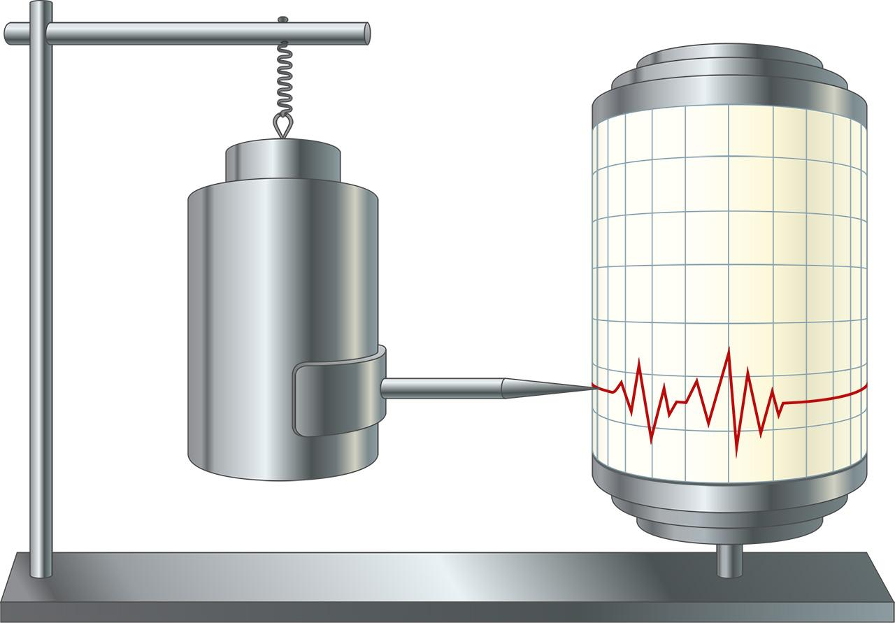
What is a seismometer
An instrument for measuring the direction, intensity, and duration of earthquakes by measuring the movement of the ground.
https://www.seis-insight.eu/en/public-2/planetary-seismology/how-a-seismometer-works

Slide 30
Seismometers online
https://shakenet.raspberryshake.org/#?net=AM&sta=RF7A3

Slide 31
Presentation of a seismometer in use.
The following slides are from a presentation by an owner of a seismometer in Dublin.
Pablo Rodriguez Salgado
Fault Analysis Group
School of earth science,
UCD.

Slide 32
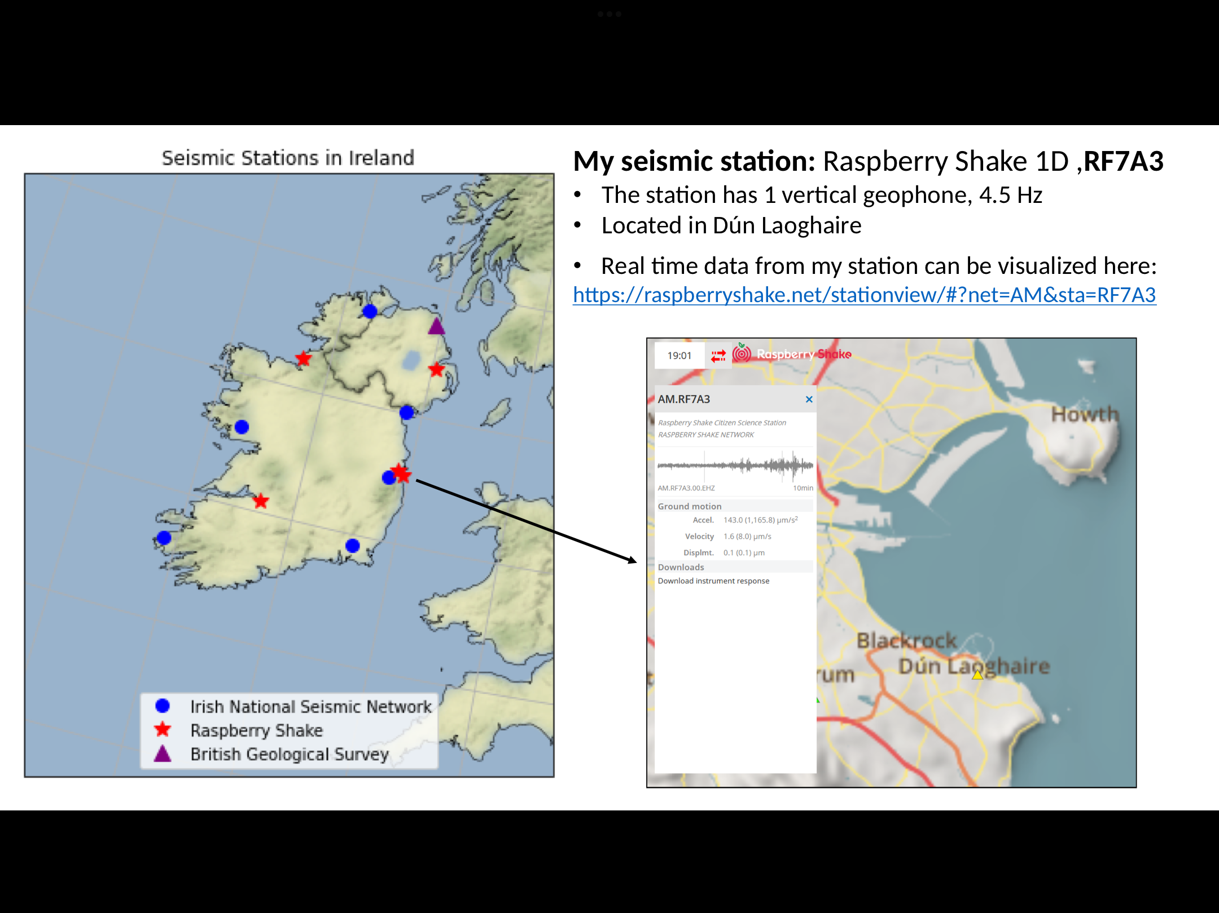
Where can they be found

Slide 33
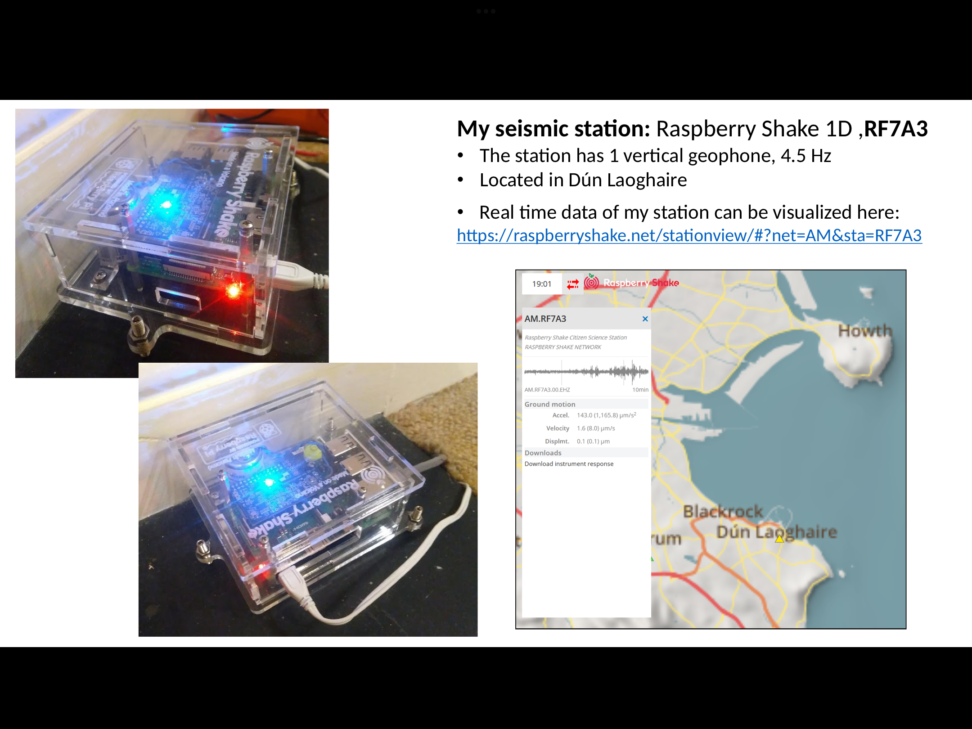

Slide 34
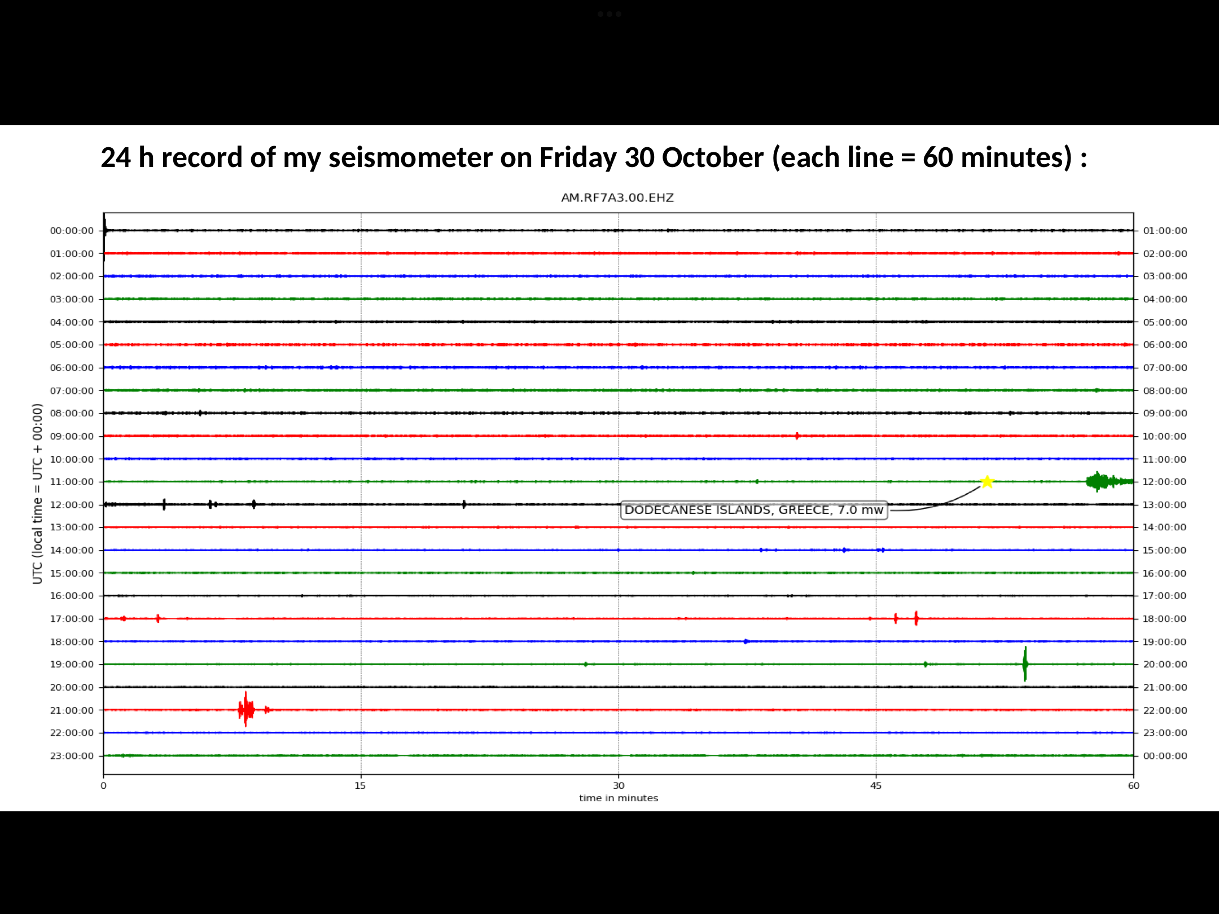

Slide 35
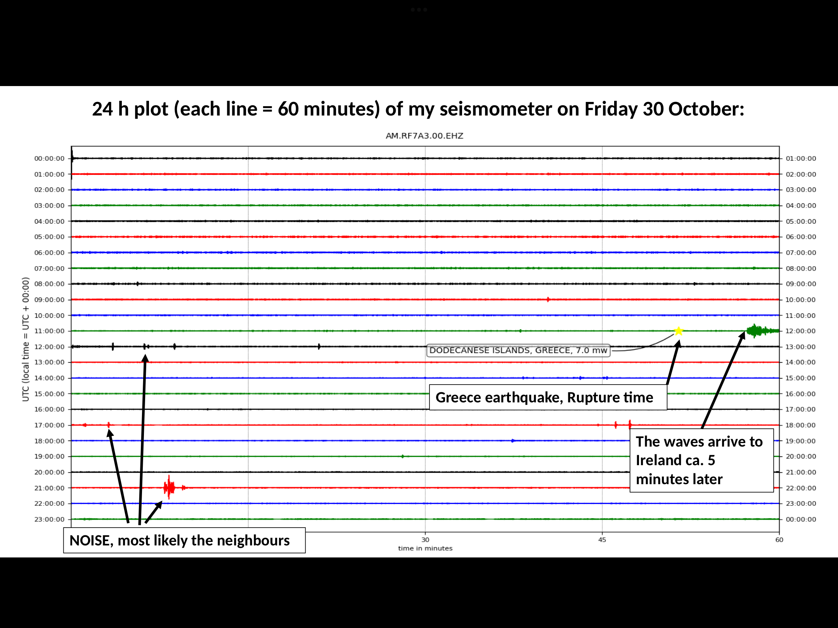

Slide 36
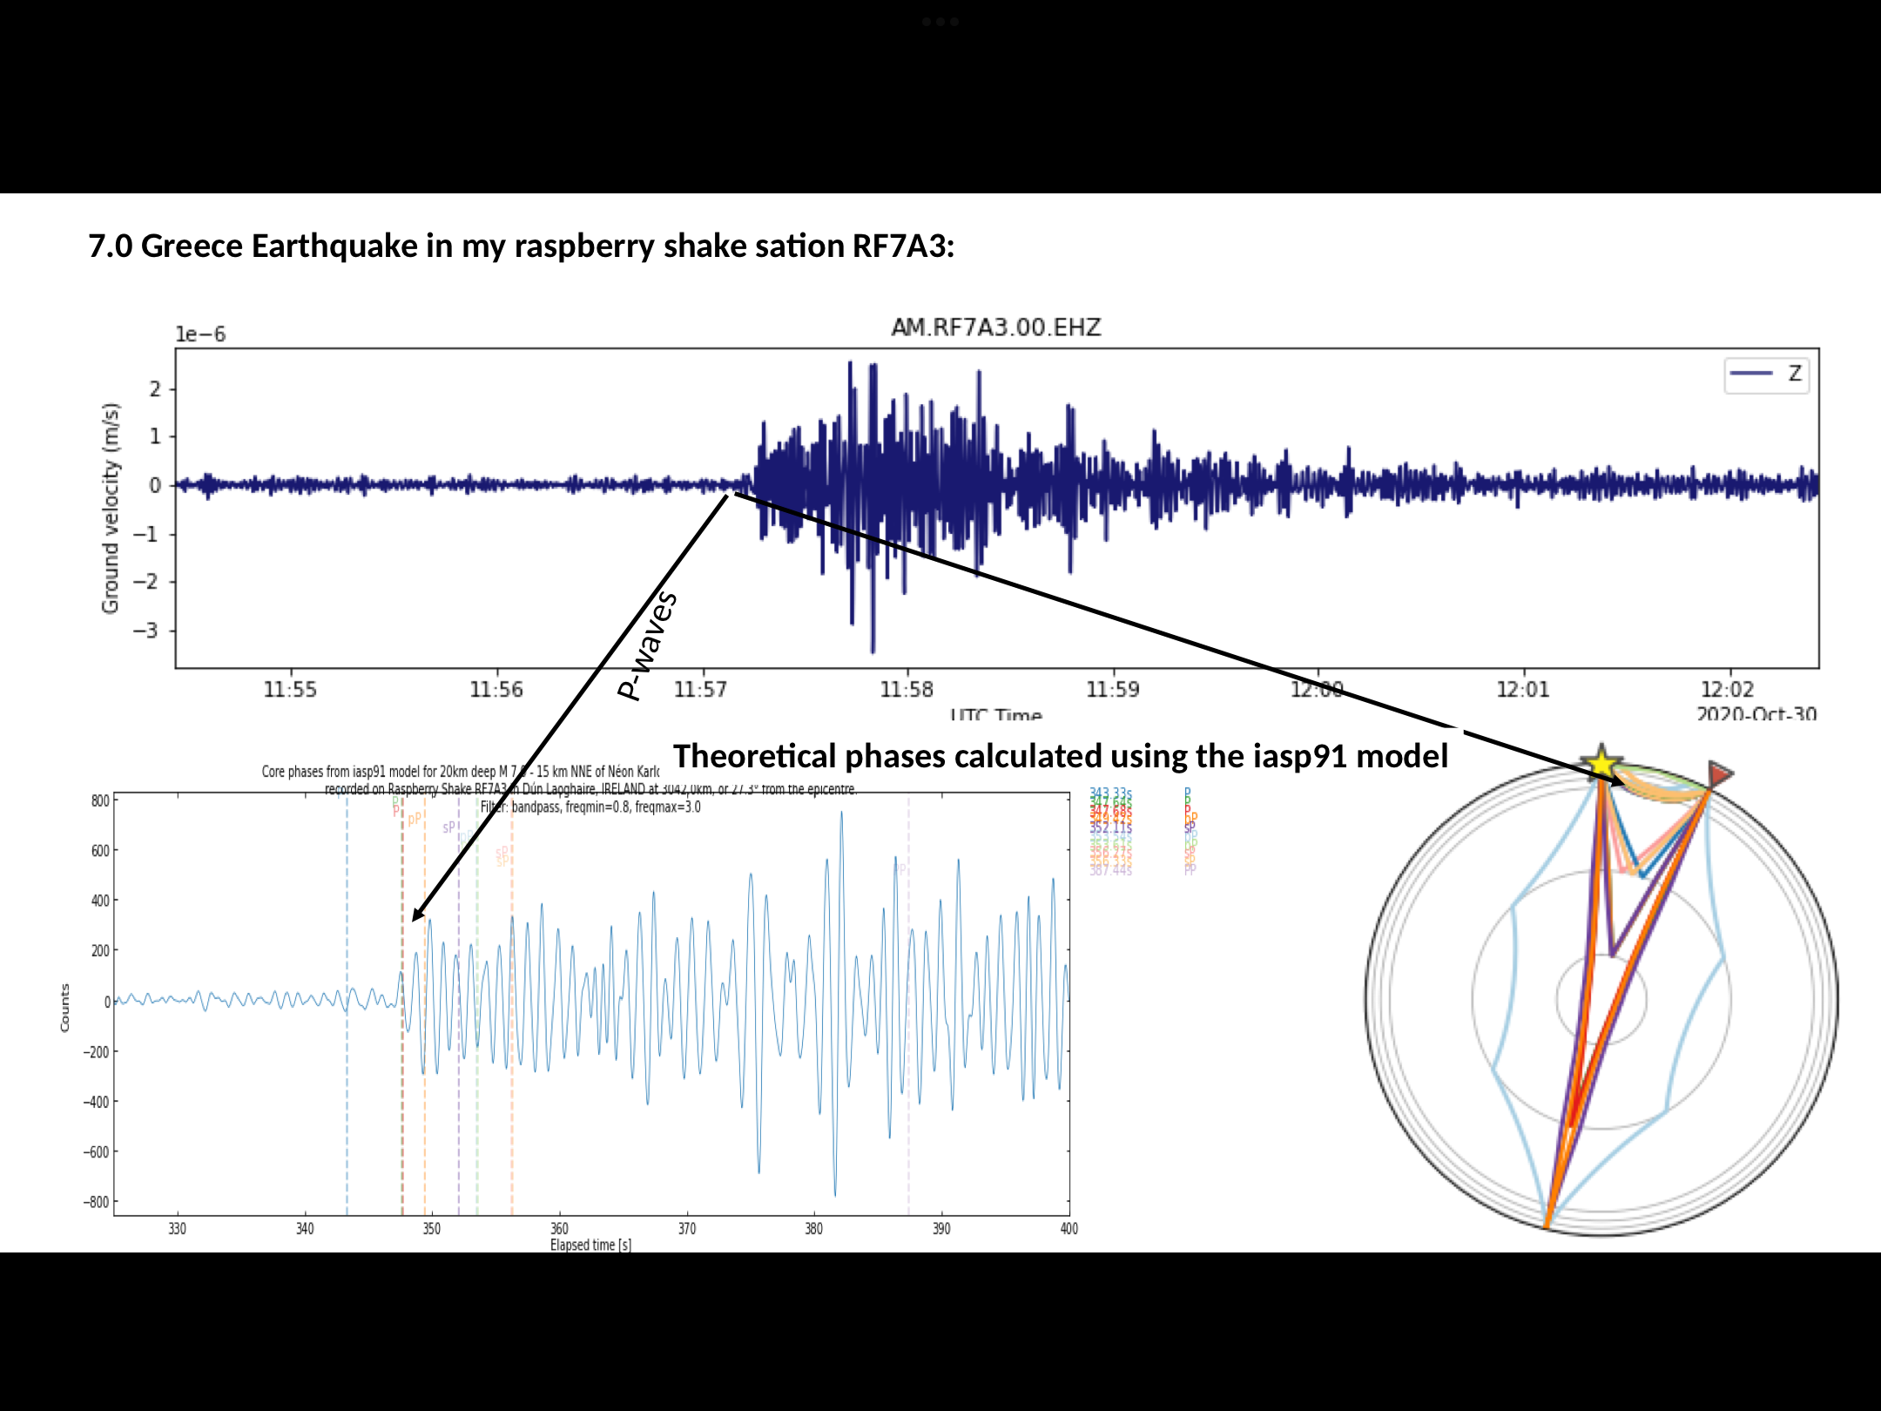

Slide 37
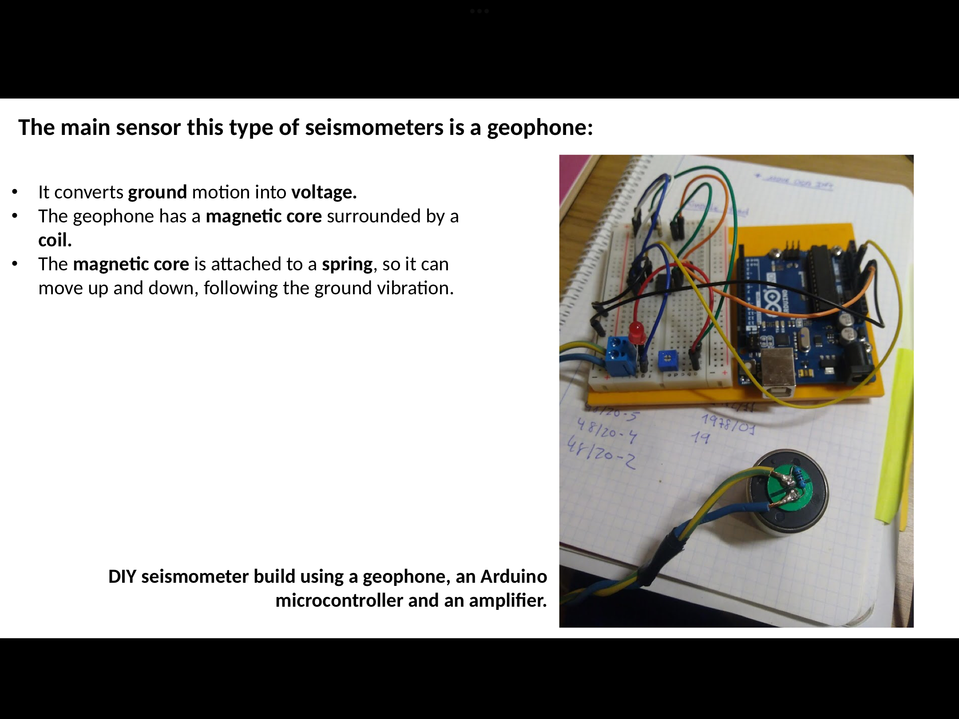

Slide 38
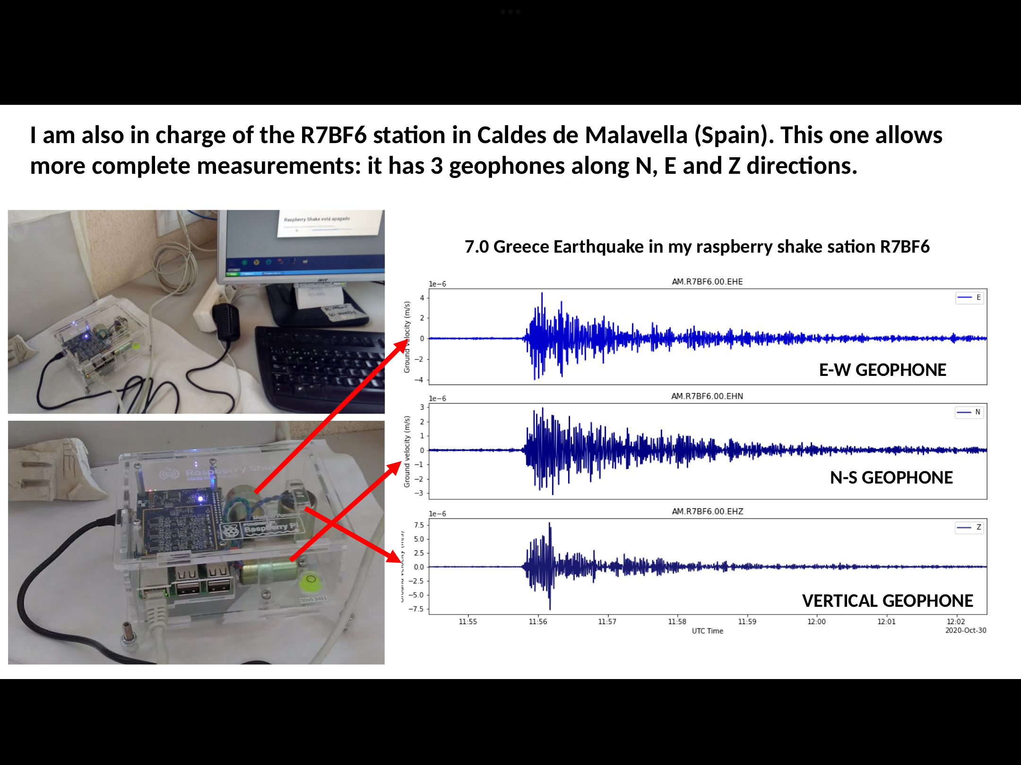

Slide 39
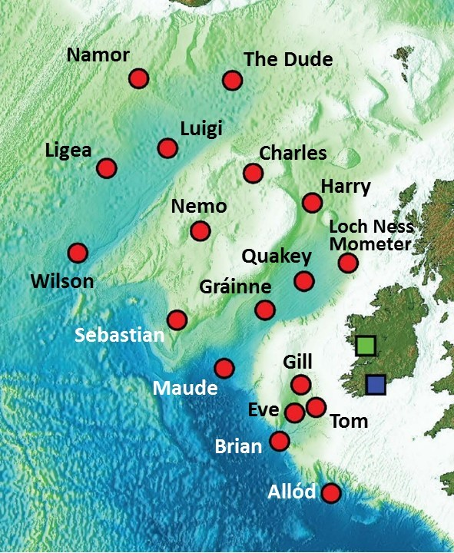
Where can they be found off the Irish coast
https://youtu.be/13TEKNP7lBY
In the project SEA-SEIS (Structure, Evolution And Seismicity of the Irish offshore), scientists from the Dublin Institute for Advanced Studies (DIAS) have deployed 18 seismometers at the bottom of the North Atlantic Ocean.
https://sea-seis.ie/2018/08/08/project-sea-seis/

Slide 40
Richter scale
There are three scales used to measure earthquakes. The Richter Scale measures the strength or intensity of the shock waves produced. The scale is measured in steps from 1 upwards. Each successive unit is 10 times more powerful than the one before. `Therefore an earthquake measuring 7 on the Richter Scale is 1,000 times more powerful than one measuring 4.
Up to 3.5 = Generally not felt, but recorded.
Under 6 = At most slight damage to well constructed buildings, but can cause major damage to poorly constructed ones over a small area.
Over 8 = Major Earthquake. Can cause serious damage over large areas of several hundreds of kilometres.
May 22, 1960: the largest earthquake ever recorded, occurred off the coast of southern Chile- measured 9.5 magnitude on the Richter scale.

Slide 41
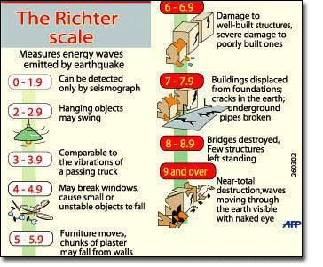
https://www.sms-tsunami-warning.com/pages/richter-scale#.YazJNC-nwgo

Slide 42
2. mercalli scale
The Mercalli Scale measures the severity of earthquakes. It relies on how much damage is caused. It measures 1 to 12 using Roman numerals.
I = Only detected by instruments.
V = Tall objects rock. Plaster cracks.
XII = Total destruction. Ground thrown into waves. Objects thrown into the air.

Slide 43
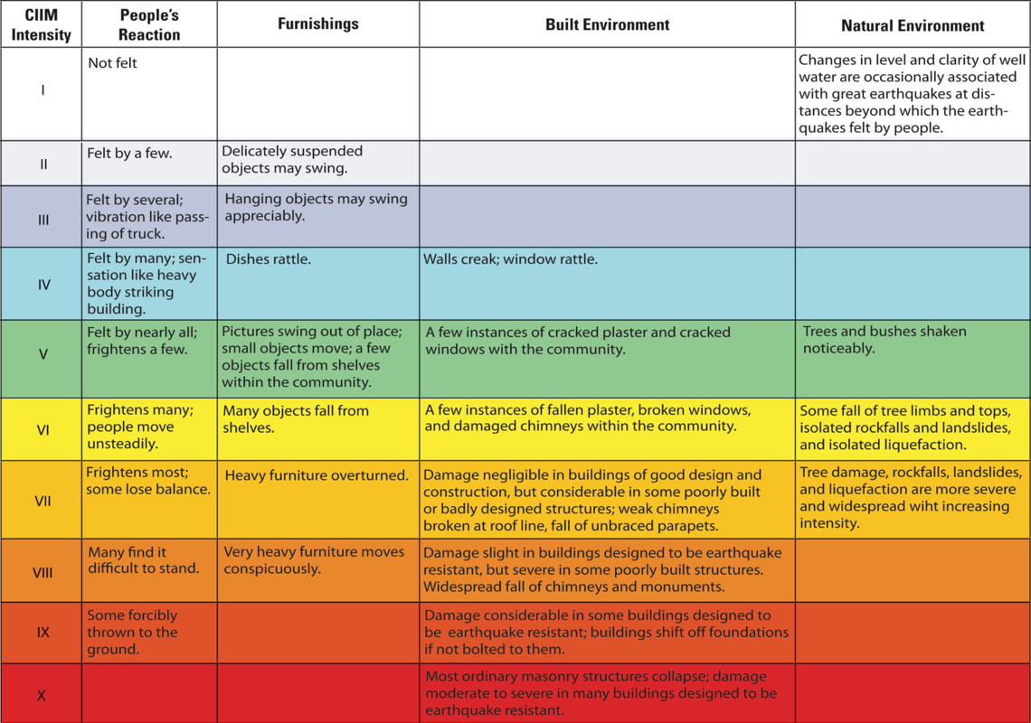
https://www.usgs.gov/media/images/modified-mercalli-intensity-mmi-scale-assigns-intensities

Slide 44
3. Moment magnitude scale
The Moment Magnitude Scale is the successor to the Richter Scale and is today used by seismologists. It measures the energy produced by earthquakes. It again goes from 1 upwards. At each step about 32 times more energy is released than at the previous step. It has no upper limit, but the largest recorded earthquake was in Chile in 1960 which measured 9.5 on the Moment Magnitude Scale. The Kashmir earthquake in October 2005 which killed over 100,000 people and left hundreds of thousands homeless measured 7.6 on the M M Scale.

Slide 45
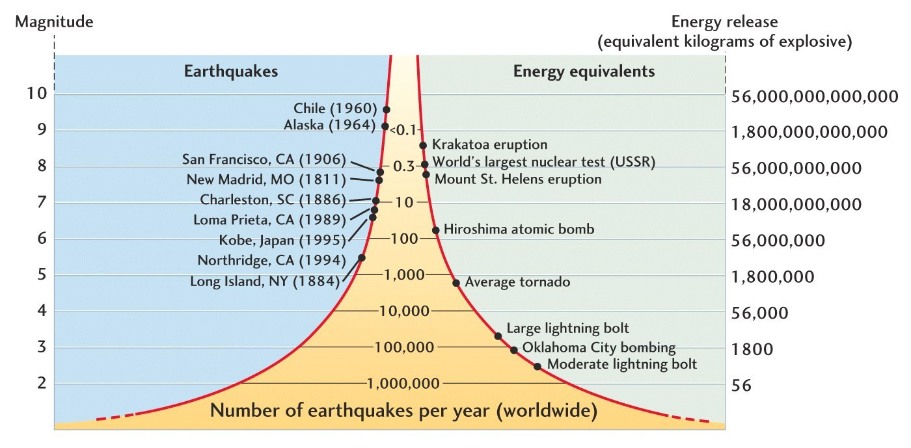
https://www.jkgeography.com/measuring-earthquakes.html

Slide 46
Predicting earthquakes
Seismologists can measure how much stress a certain region of the Earth's crust is under, and how quickly that stress is increasing. This knowledge, along with the elapsed time since the last quake, helps scientists to determine if another quake is on the way.

Slide 47
Activity
Take a trip to the local primary school where a seismometer might be present. http://geoserver.iris.edu/stations/view/SIE#zoom=4&lat=52.69886&lon=-11.86523&layers=TFFBFFFFFFFFFFF
Make a seismometer. https://youtu.be/41RzGwZINOk
As part of the project- talk about what is a seismometer.
Look and where they are located both in Ireland and abroad.
Why do you think they are located here?
Pick one of the scales mentioned and write up how they work.

Slide 48
Key terms
Seismometer- an instrument used to measure earthquakes.
Magnitude- the strength of an earthquake.

Slide 49
Earthquake damage and the impacts of earthquakes
Lesson three

Slide 50
Learning outcome
Understand earthquake damage and the effects of earthquakes.

Slide 51
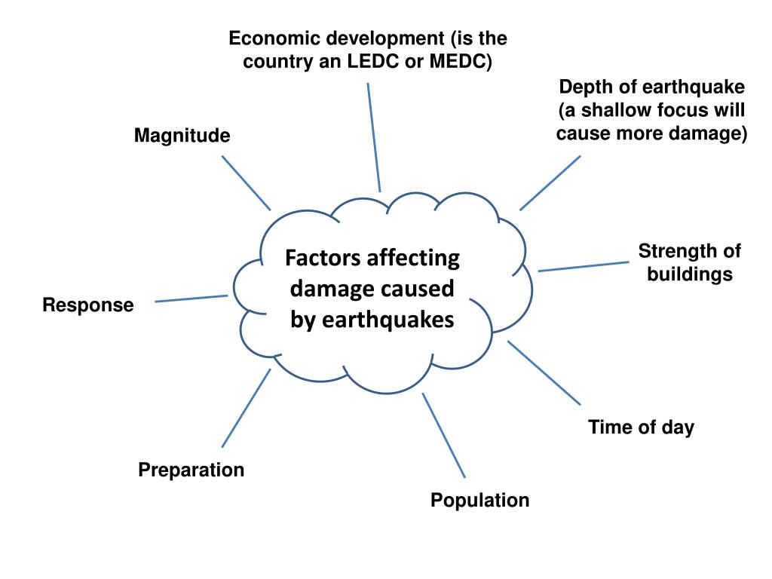
https://www.slideserve.com/daryl/earthquakes-don-t-kill-people-buildings-do

Slide 52
Factors effecting earthquake damage
The amount of property damage, injuries to people and loss of life depend on a number of factors including;
The time of day.
The time of year.
The population density.
The type of construction of the various structures.
The geology of the region.
The magnitude and duration of the earthquake.
The distance from the epicentre.

Slide 53
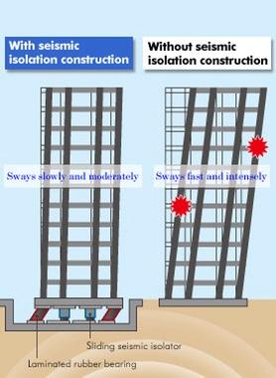
Earthquake proofing buildings
https://web-japan.org/trends/11_sci-tech/sci110728.html

Slide 54
Destruction
Vibrations destroy buildings
liquefaction turns the ground into a quicksand.
Houses and roads are swept away, valleys blocked and rivers dammed by avalanches and landslides.
Fires cause major damage in urban areas and the problem is made worse by the lack of water due to burst mains.
Earthquakes that have their focus under oceans generate large seismic waves called tsunami.

Slide 55
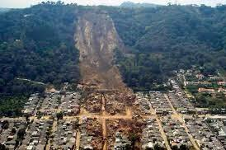
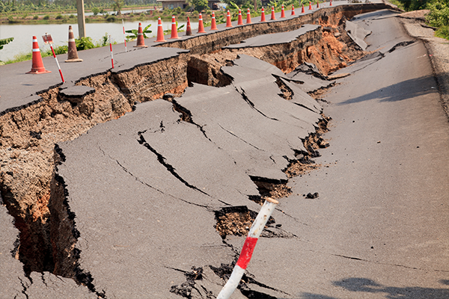
https://www.earthquakeauthority.com/Blog/2020/How-Earthquakes-Cause-Damage-Destruction

Slide 56
Impacts of earthquakes
short term (immediate) impacts.
long term impacts.
social impacts (on people).
economic impacts (on the wealth).
environmental impacts (on the landscape).

Slide 57
 | Social impacts | Economic impacts | Environmental impacts
Short term | People may be killed or injured. Homes may be destroyed. Essential services may be disrupted. Transport and communication links may be disrupted. Water pipes may burst and water supplies may be contaminated | Shops and businesses are destroyed. Looting may take place. Transport and communications systems are disrupted so trade is difficult. | The built landscape is destroyed. Fires spread due to broken gas pipes. Fires can damage areas of woodland. Landslides may occur. Tsunamis may cause flooding in coastal areas

Slide 58
 | Social impacts | Economic impacts | Enviornmental impacts
Long term impacts | Disease may spread. People have to be re-housed, sometimes in refugee camps. | The cost of rebuilding is high. Investment in the area is focused only on repairing the damage caused by the earthquake. Income is lost. | Important natural and human landmarks may be lost.

Slide 59
In class activity
You are a county councillor or emergency services worker.
think of the impacts from the perspective of the character/role they are playing?
Write down your answers.
Discuss with the person next to you.
Discuss with the class group.

Slide 60
Activity - project
Pick an earthquake that has occurred over the last 100 years. Answer the following:
When did this earthquake occur?
Where did this earthquake occur?
Why did this earthquake occur?
What was the measurement of this earthquake?
Look at the impacts this specific earthquake had- look at this under the headings short term and long term impacts in relation to social, economic and environmental impacts.

Slide 61
Key terms
Population density- the amount of people per square kilometre.
Geology- the study of rocks.
Liquefaction- the process of making something liquid.
Tsunami-a large tidal wave caused by underwater activity such as an earthquake.
Contamination- polluting or poisoning something ie. Water.

Slide 62
tsunamis and the causes of
Lesson four

Slide 63
Learning outcome
Understand what is meant by a tsunamis and the causes of
Develop an understanding of international examples of tsunamis and the effects.

Slide 64
What do you know about tsunamis

Slide 65
What is a tsunami
Tsunami is the Japanese for"harbor wave." It is a large wave caused by movements in Earth's crust, which move ocean water. It can be caused by an earthquake, volcanic eruption or a submarine slide.

Slide 66
Tsunamis caused by earthquakes
Occurs at convergent or transform boundaries or faults, by sudden release of energy stored in the earth’s crust.
Earthquakes are a common form of tsunami
https://youtu.be/ILlyfwDwJVs

Slide 67
Tsunami caused by volcanic eruptions
Tsunami can be initiated by volcanic eruptions are less common. They can occur as a result of:
collapse of coastal or underwater volcanoes which can result in massive landslides.
pyroclastic flows falling into the ocean displacing the water.
a caldera volcano underwater collapsing after an eruption causing overlying water to drop suddenly.
https://youtu.be/AXHN14IHtLY
https://www.ga.gov.au/scientific-topics/community-safety/tsunami
Information collected from the above site.

Slide 68
Tsunami caused by underwater slides
Landslides can occur on the seafloor- known as submarine slides. Areas of the seafloor that are steep and loaded with sediment, such as the edge of the continental slope, are more prone to underwater slides or submarine landslides.
When submarine slides occur (perhaps after a nearby earthquake) a large mass of sand, mud and gravel can move down the slope. This movement will draw the water down and may cause a tsunami that will travel across the ocean.
https://youtu.be/feXCIfatJYo

Slide 69
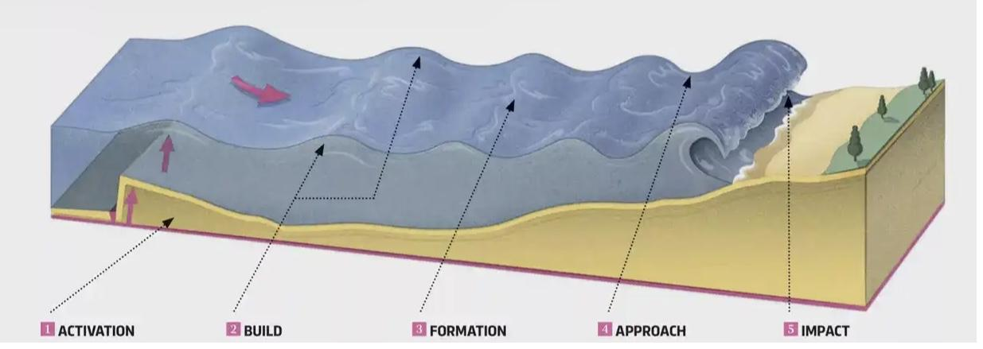
https://www.sciencefocus.com/planet-earth/how-do-tsunamis-form/

Slide 70
Destruction
Two phases of destruction when a tsunami hits:
First as the wave crashes onto coastal areas.
Second as the water from the wave pulls back into the sea bringing with is large amounts of debris from the land.
Tsunamis can range in size from 1 or two metres to Mega-tsunamis hundreds of metres high.the largest tsunamis form when a large object or mass enter the water ie. Landslide.
Information From:
https://www.gsi.ie/en-ie/geoscience-topics/natural-hazards/Pages/Tsunami.aspx

Slide 71
Tsunami statistics
The largest tsunami ever recorded was in Lituya Bay, Alaska and measured 520 metres tall and was as a result of a massive landslide falling into Lituya Bay.
Spanish Arch in Galway was very badly damaged by a tsunami as a result of a massive earthquake that occurred just of the Lisbon coast in Portugal in 1775.
Information:
https://www.gsi.ie/en-ie/geoscience-topics/natural-hazards/Pages/Tsunami.aspx

Slide 72
Activity - project
Pick a tsunami that has occurred over the last 30 years. Answer the following.
When did this tsunami occur?
Where did this tsunami occur?
What caused this tsunami to occur?
What were the short term and long term impacts of this tsunami on the area. Look at this under the headings social, economic and environmental impacts.
Research early warning systems and the part they have to play in reducing impacts.

Slide 73
Key terms
Submarine slides -Mass movement of sediment across the continental shelf into deeper water
Continental shelf - Area of sea bed around a land mass where the water is relatively shallow.
Pyroclastic flow - A fast moving flow of volcanic material ie. Lava, ash, rock bombs etc
Caldera - Volcanic crater caused by the collapse of the mouth of a volcano
Mega Tsunamis- Very large wave caused by displacement of water in the ocean- waves of 50m + at source.

Slide 74
The impact of seismic activity in Ireland.
Lesson five

Slide 75
Learning outcomes
Understand how seismic activity is measured in Ireland.
Understand the historical impact of seismic activity off the Irish coast- examples of earthquakes that have affected coastal landforms.
Understand the ways a tsunami could possibly happen off the coast of Ireland in the future.
Understand the impacts of a tsunami in the cork harbour and coastal area.

Slide 76
Discussion point
Is Ireland affected by seismic activity.

Slide 77
research of seismology in Ireland
IMARL deep ocean listening:
https://imarl.ie/about/
Joint partnership with:
Science foundation Ireland
DIAS-Dublin Institute of Advanced studies
Geographical survey Ireland
iCRAG-Irish Centre for Research in Applied Geoscience.

Slide 78
Activity
Go to the website on the previous page and research the sensors in on the ocean floor.
It comprises broadband Ocean Bottom Seismographs (OBS), broadband acoustic sensors, and sensors for measuring absolute water pressure & temperature at the ocean floor. A system capable of detecting tsunamis also forms part of the infrastructure.
To see the most recent earthquakes detected in Ireland the Irish National Seismic Network:
https://www.insn.ie/

Slide 79
strongest earthquake recorded in Ireland
Ireland's biggest ever recorded quake hit in 1984, when an earthquake with a magnitude of 5.4 caused minor structural damage on the east coast.
The epicentre of the quake was about 10 miles off the coast of Anglesa in Wales and measured over 5.5 on the Richter scale.
https://www.rte.ie/archives/2019/0617/1055768-east-coast-earthquake/

Slide 80
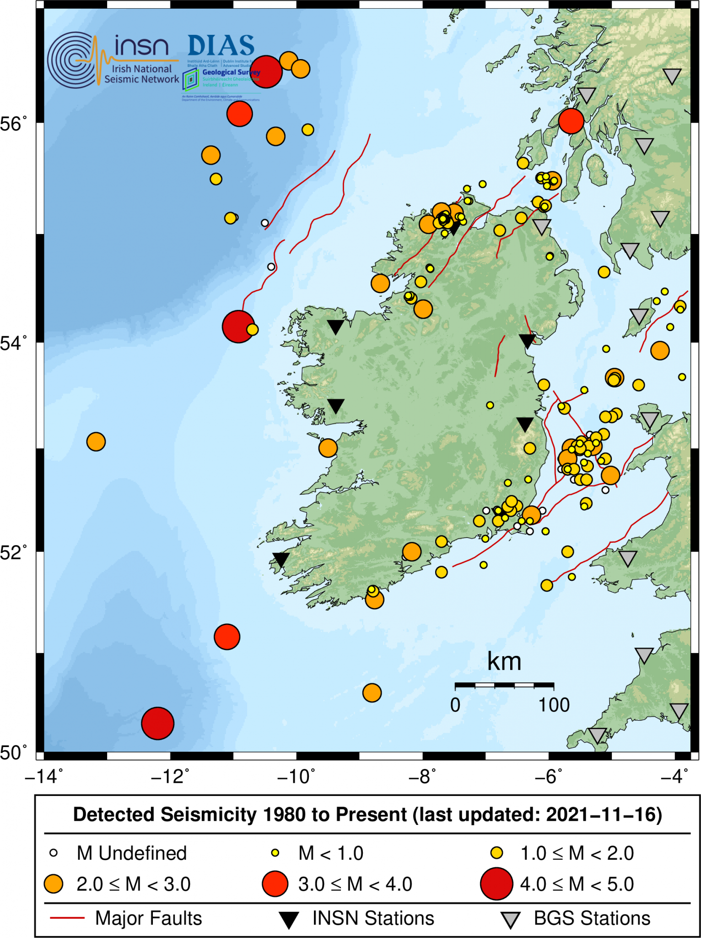
The map shows the epicentre locations of all earthquakes reported by the INSN since 1980
https://www.insn.ie/wp-content/uploads/2021/11/earthquakes.1980_to_2021-11-16.csv

Slide 81
Instances of seismic activity of the Irish coast
Irish National Seismic Network
Monitor seismic activity around the Irish coast.
Most recent: 31st of March 2021-a magnitude M2.6 earthquake occurred in the Rockall Trough, approximately 210 km north-northwest of Ireland.
https://www.gsi.ie/en-ie/programmes-and-projects/geohazards/activities/Pages/Irish-National-Seismic-Network.aspx

Slide 82
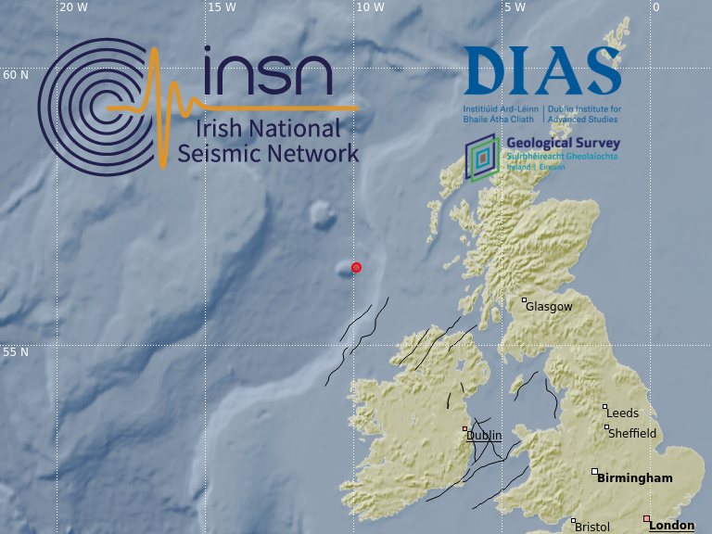
https://www.insn.ie/2021-03-31-m2-6-m2-3-rockall-trough/

Slide 83
Further instances
Some examples of predicted inundated (flooded) areas in Galway/Dunmore East are visible in this paper:
https://www.mdpi.com/2076-3263/10/6/226/htm

Slide 84
Tsunami activity in Ireland

Slide 85
Events that could cause a tsunami off the Irish coast
Earthquake activity example 1755 Lisbon earthquake
Volcanic eruptions
Submarine slides- storegga slides

Slide 86
Historical impact of tsunamis off the Irish coast
Lisbon earthquake of 1755 and 1761
Storegga Slide

Slide 87
Lisbon earthquake 1755
When : November 1st 1755
Where: 200 km south of Lisbon.
Why: area lies close to a major fault line separating Eurasian and North African plates.
Lasted: 9 minutes
Estimated intensity: 8.5-9 on the Richter scale.
Tsunami affected: Portugal, Spain, Brazil, North Africa, Britain and Ireland.
March 30th 1761- earthquake felt in cork city followed by a second tsunami
Animation: https://youtu.be/Ht0W2E9g8cA

Slide 88
Image shows Tsunami travel time chart for the 1755 Lisbon tsunami. Red color shows the area within 1-hour propagation time.
http://www.deepmapscork.ie/past-to-present/climate/1755-lisbon-earthquake-tsunami-west-cork-coast/

Slide 89
Impacts of a tsunami on the south coast of Ireland
https://youtu.be/zqcdeMmJy1E
Record of a tsunami event in west cork at Trailspean Bay.
https://youtu.be/N0lN_f4JijE
Deposits left by tsunami in west cork.

Slide 90
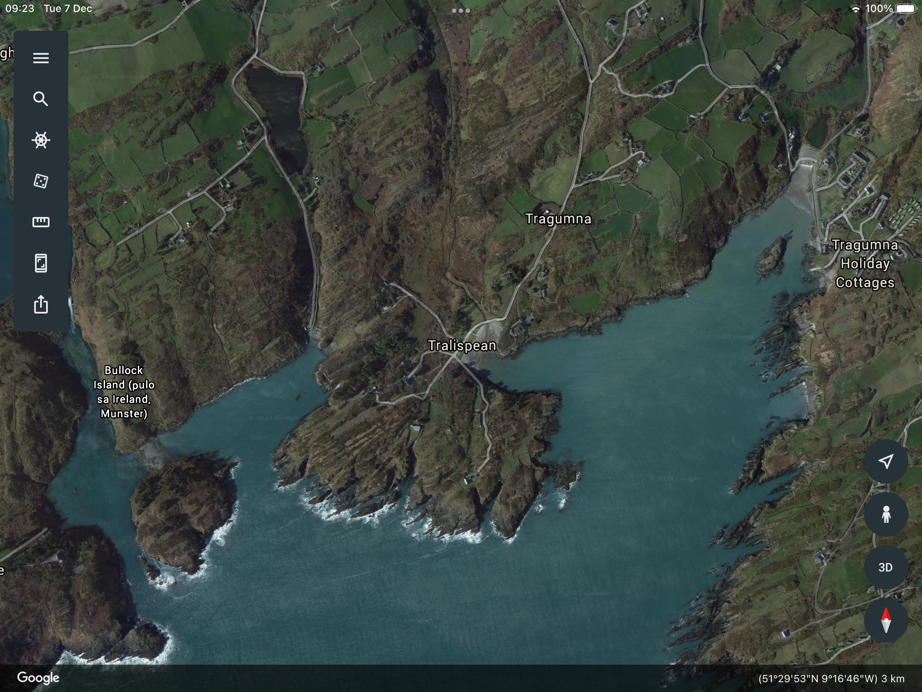

Slide 91
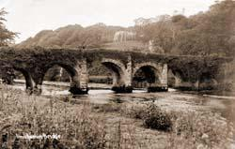
Impact on the cork coast line and further inland
The wave travelled up the estuary of the Bandon River from Kinsale as far as Innishannon, completely destroying the bridge here. https://www.valleyrovers.com/news_detail/368057/

Slide 92
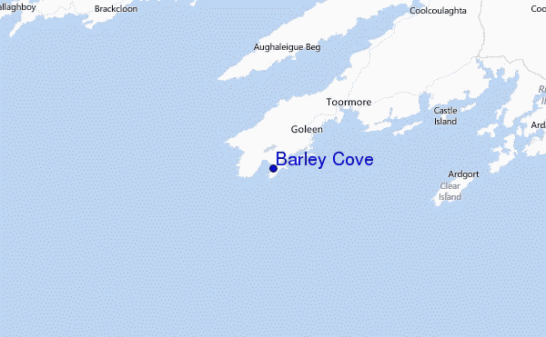
Barley cove
Lisbon earthquake 1755 created a tsunami 4.5 metres high when it reached Barleycove Bay in West Cork.
This dramatically changed the shape of the bay, creating the dunes we can still see but also saltmarshes and grasslands which provide habitats for plants and animals.

Slide 93
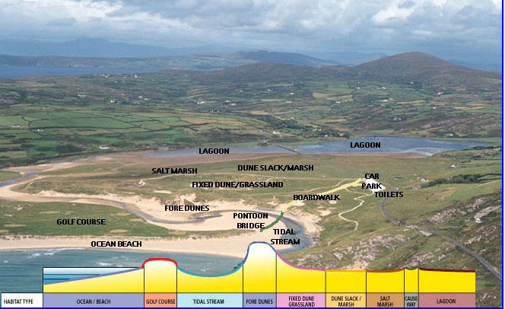

Slide 94
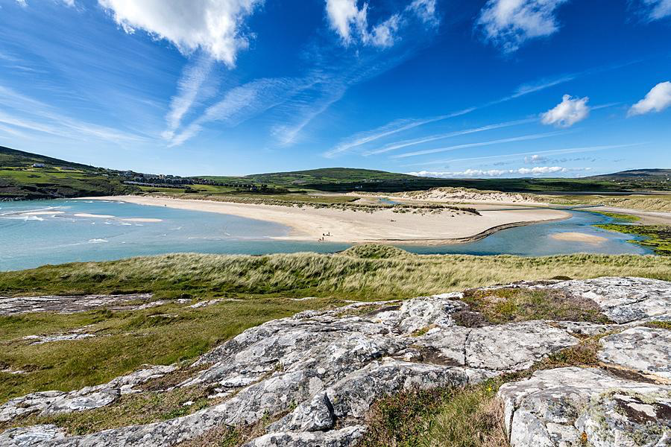

Slide 95
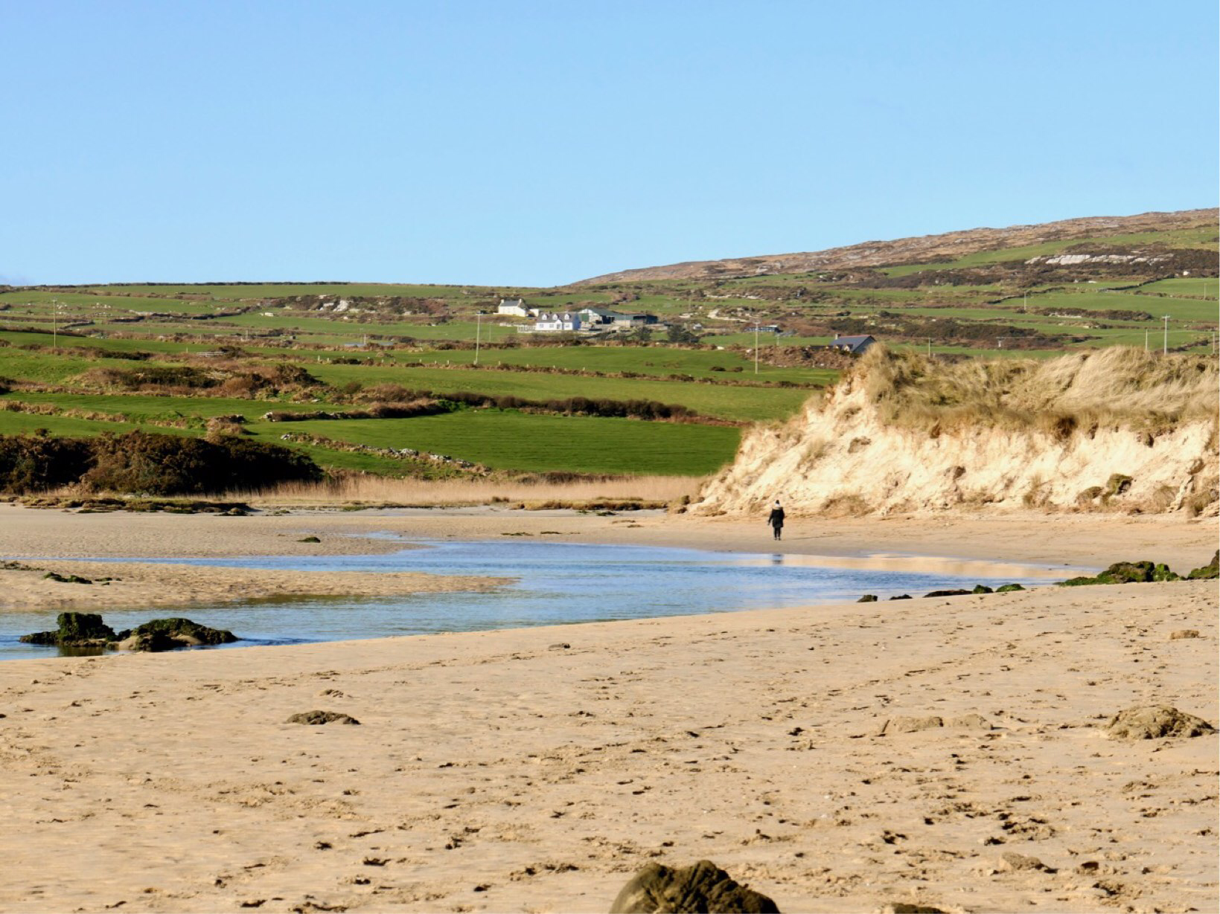

Slide 96
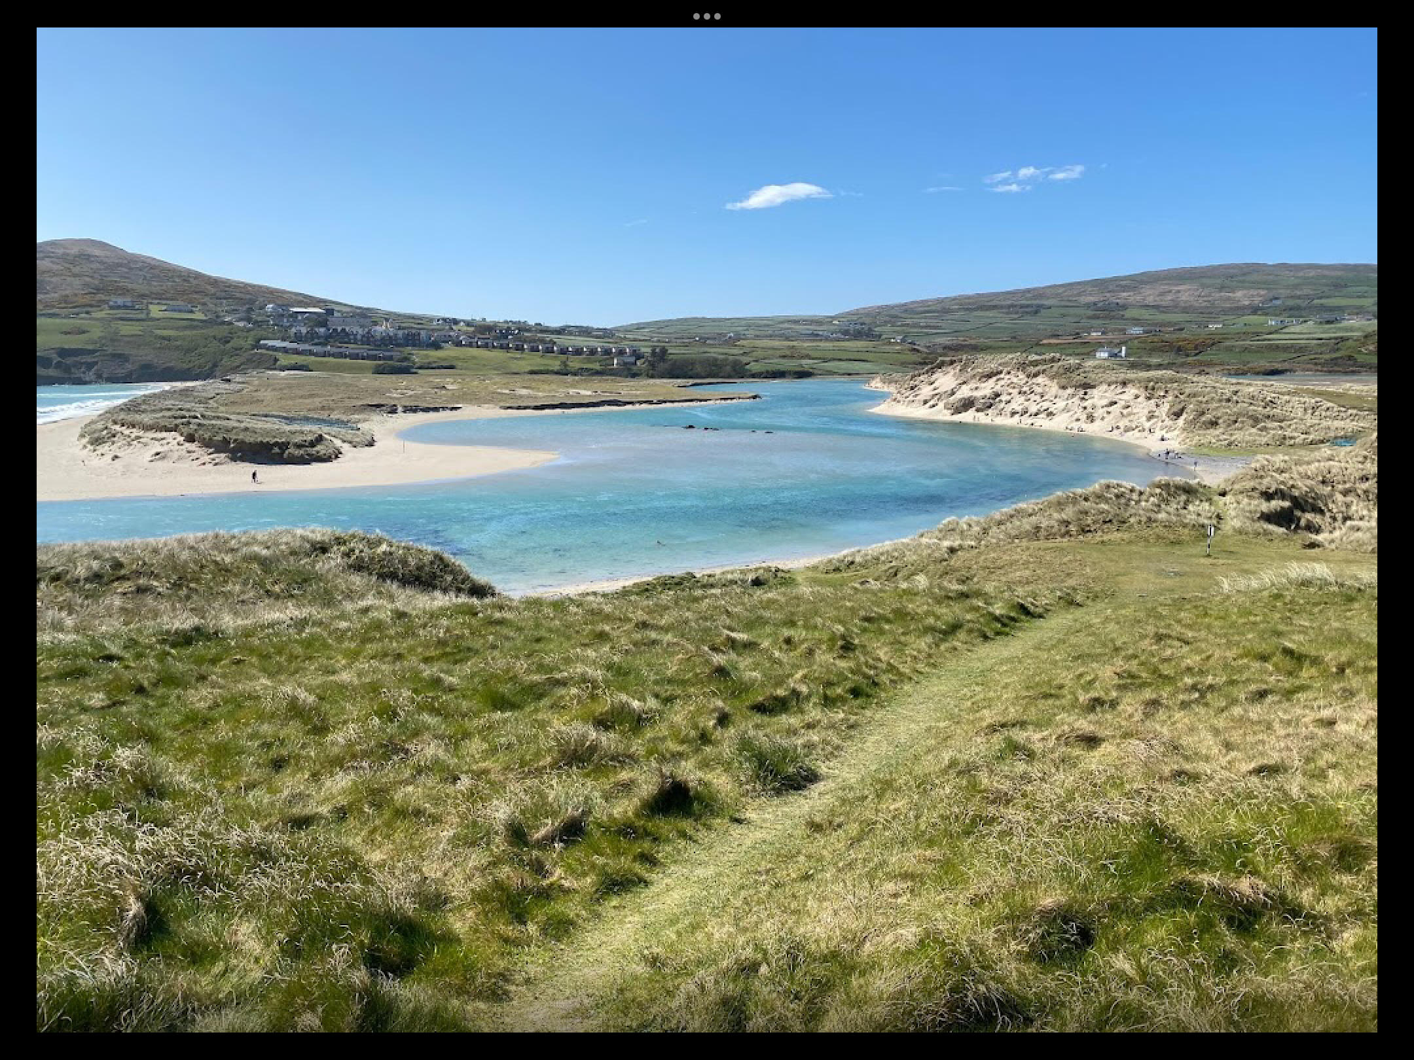

Slide 97
Storegga slide
https://youtu.be/Nomlo8X58PY
The Storegga slides collapsed 290km of continental shelf with a total volume of about 3,500 cubic kilometres of debris approximately 8200 years ago.
Ireland affected by waves 3-5 m in height.

Slide 98
How do we know
Primary and secondary sources.
A letter from 1755 describes the arrival of the tsunami in Kinsale:
…a large body of water suddenly poured into the harbour … the successive risings and fallings of the water continued about 10 minutes… By different accounts received here the water was affected in the same manner along the coast, to the westwards of this harbour.
Source: http://www.deepmapscork.ie/past-to-present/climate/1755-lisbon-earthquake-tsunami-west-cork-coast/

Slide 99
Monitoring of tsunamis off the Irish coast
Unlikely to happen.
1755 and 1761 Lisbon earthquake proves it is possible.
Ireland has yet to establish a 24/7 national warning centre, we receive tsunami messages from the French (CENALT) and Portuguese (IPMA) warning centres, which are accredited Tsunami Service Providers of NEAMTWS, via the Global Telecommunications System through Met Eireann.
GSI installed a tsunami sea level gauge on behalf of the EU JRC on Inishmore in 2019.
The DIAS iMARL project includes sea-floor seismometers and a tsunami pressure gauge, funded by SFI and supported by GSI.
https://www.gsi.ie/en-ie/programmes-and-projects/geohazards/activities/Pages/Tsunami-Hazard-and-Response.aspx

Slide 100
What would happen if a tsunami was to hit cork harbour
Likely worst case tsunamis around Ireland would be similar to the level of coastal flooding seen during storm surges, but with greater momentum and less time to react. https://www.gsi.ie/en-ie/programmes-and-projects/geohazards/activities/Pages/Tsunami-Hazard-and-Response.aspx

Slide 101
Activity
This is the final aspect of the project.
Students are asked to look at tsunamis that have effected the Irish coast.
Look at:
When they occurred.
What was the cause.
What was the impact on the Irish coastline.
Students are then asked to research the Irish tsunami action plan.
Students are asked to look at other factors that may cause a tsunami on the Irish coast and what might be th3 impact on their local area.
Students will then be allocated class time to present their individual or group project.

